Slide 1
SHARK SPECIES
OCEANIC WHITE TIP
SILVERTIP
BLUE SHARK
SHORTFIN AND LONGFIN MAKO
GREY REEF
SILKY
GALAPAGOS SHARKS
BIGEYE THRESHER

Slide 2
SHARK SPECIES
COMMON THRESHER SHARK
PELAGIC THRESHER SHARK
SANDBAR
HAMMERHEAD SHARKS
TIGER
WHALESHARK
COOKIE CUTTER

Slide 4
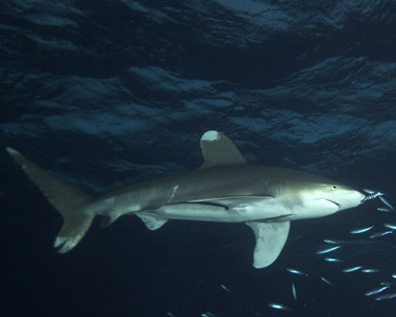
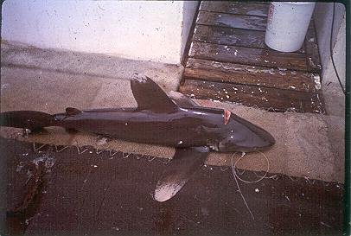
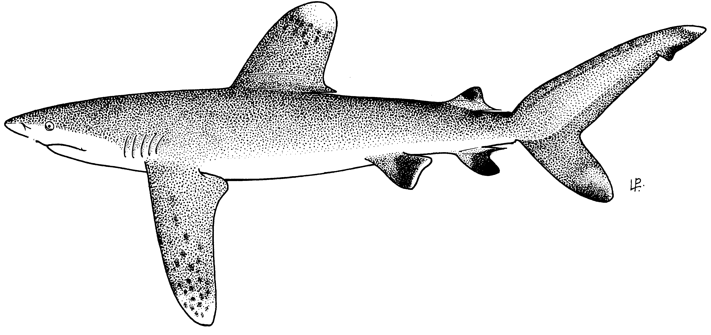
Name: Oceanic Whitetip
Code: OCS
Big round white tipped
1st dorsal fin
Long broad pectoral fins

Slide 6
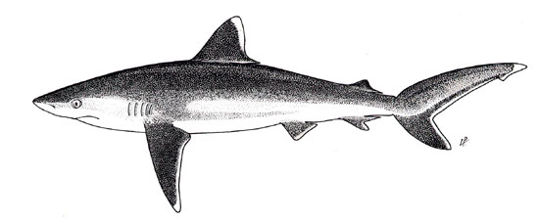
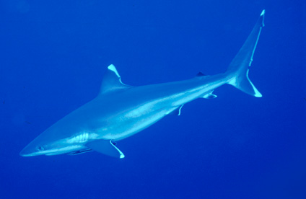
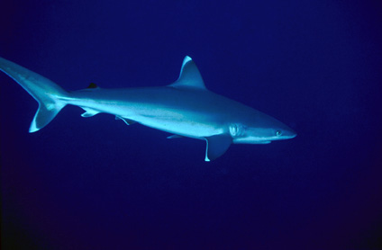
Name: Silvertip
Code: ALS
White band on edges of all fins

Slide 8
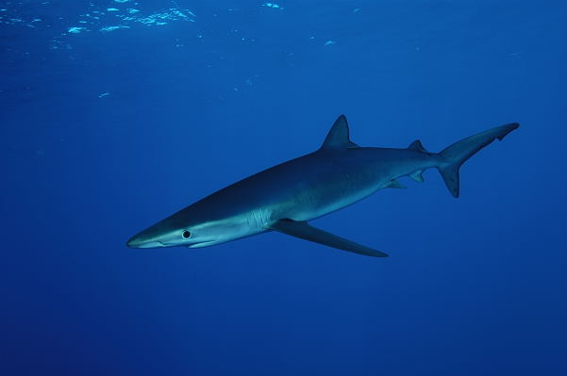
Long pectoral fin
Head is long and pointed
Blue colour in upper body
Name: Blue Shark
Code: BSH
Long pectoral fin
White colour in lower body

Slide 10
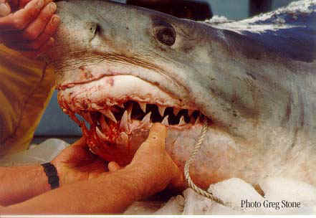
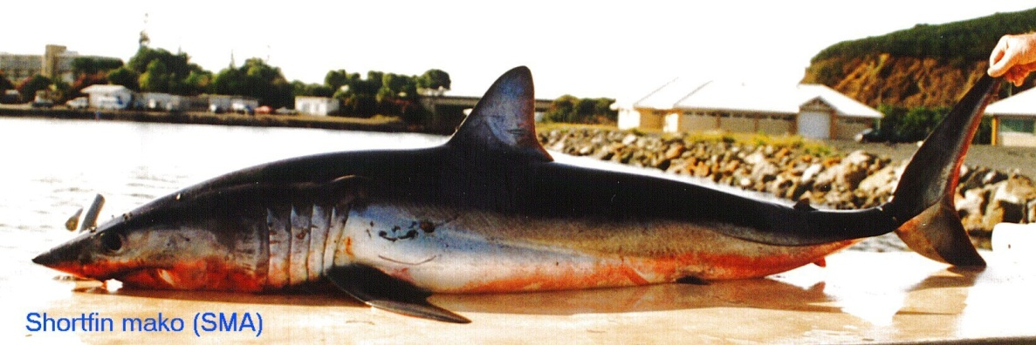
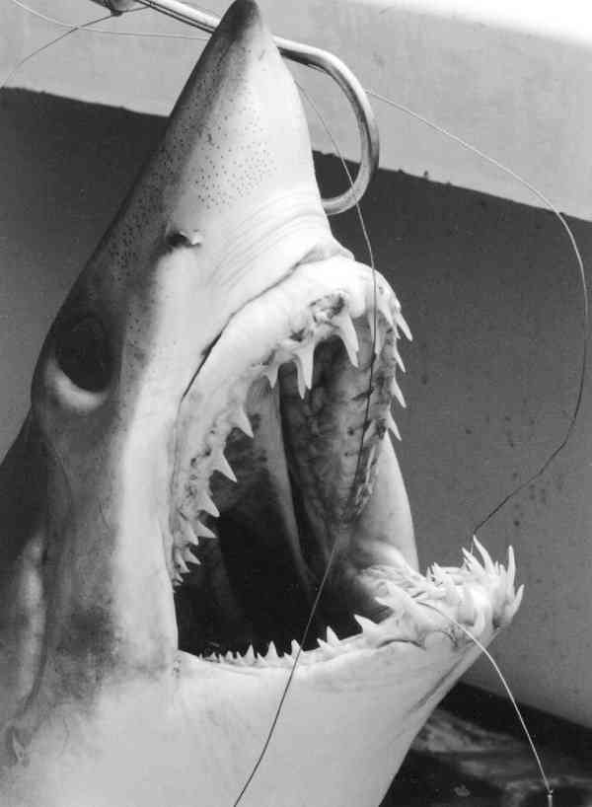
Shortfin mako: SMA
Longfin mako: LMA
Length of pectoral fin is greater than length of head then it is a Longfin (refer to picture)
Length of pectoral is less than the length of head then it is a Shortfin (refer to picture)
Note: In some circumstances that you are unable to identify it to LMA or SMA, write down MAK

Slide 13
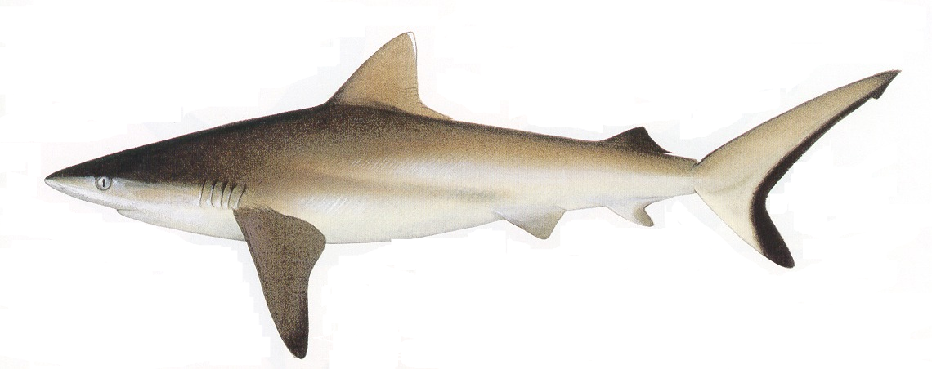
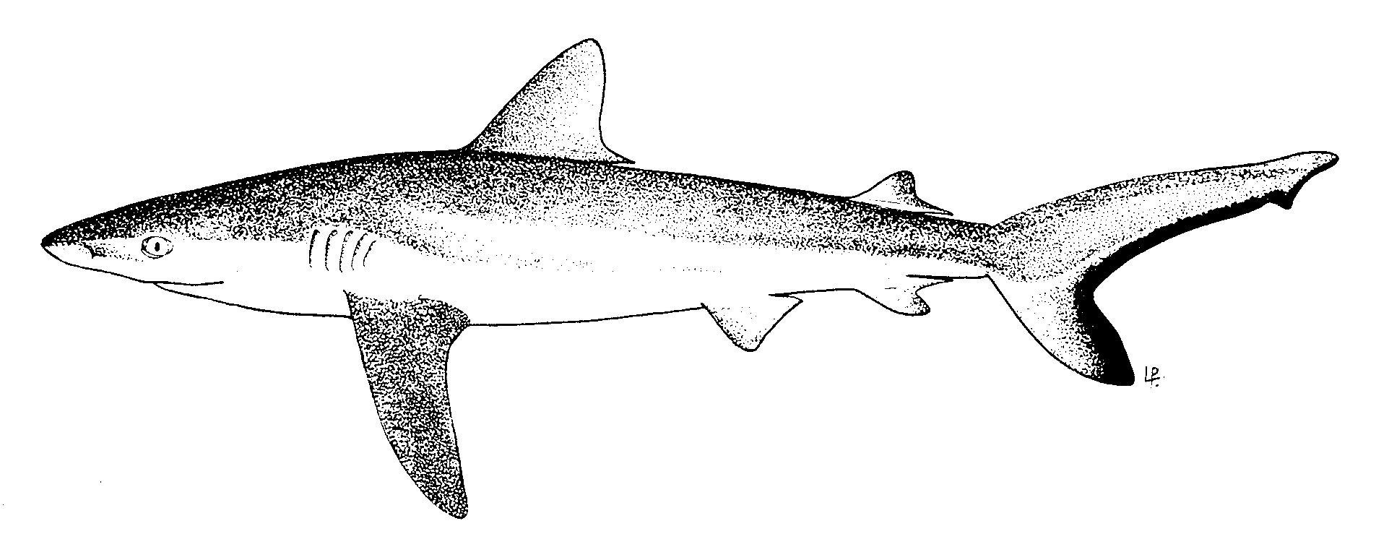
Name: Grey reef shark
Code: AML
Distinctive black band at the back
edge of tail

Slide 15
Name: Silky shark
Code : FAL
First dorsal is in front of the back edge of the pectoral fin
Round snout
small second dorsal with long free rear tip, 2 times
more than its height.
4. Only Carcharhinus species with dorsal fin origin behind the free rear tip of the pectoral fin, indicated by arrows (blue and red) in the photo

Slide 17
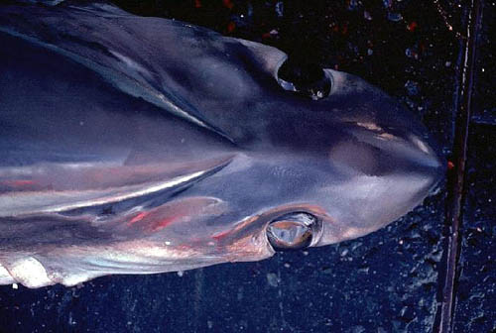
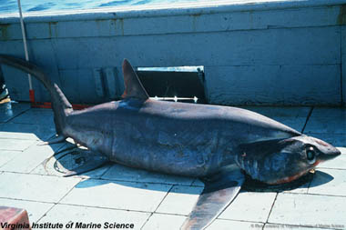
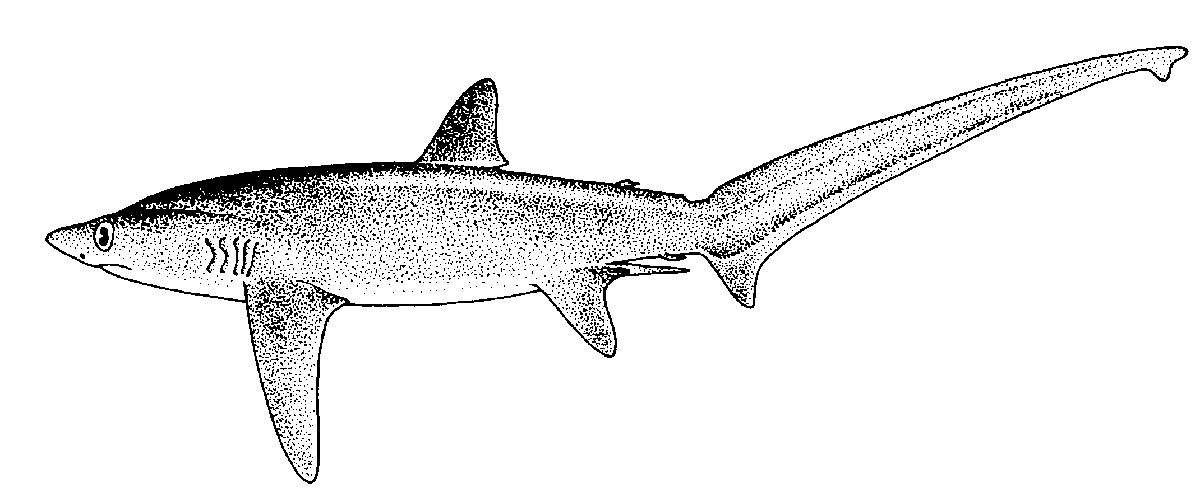
Name: Bigeye Thresher shark
Code: BTH
Very Long upper caudal tail
Large eyes
Groove on the head

Slide 19
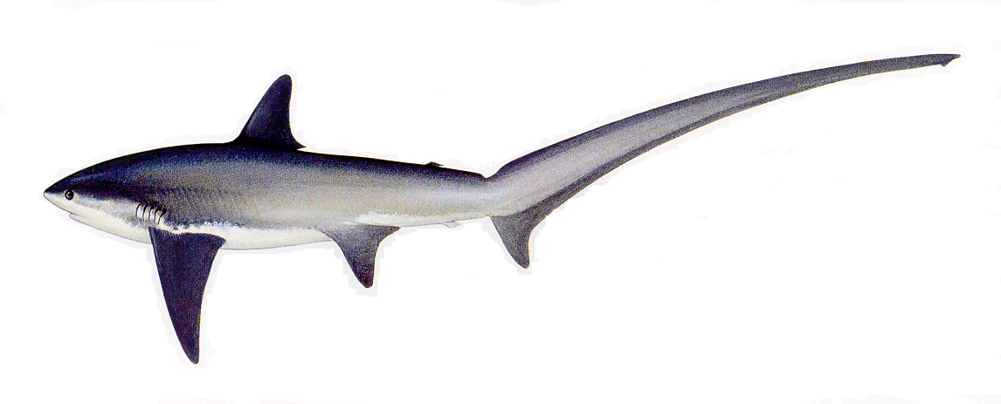
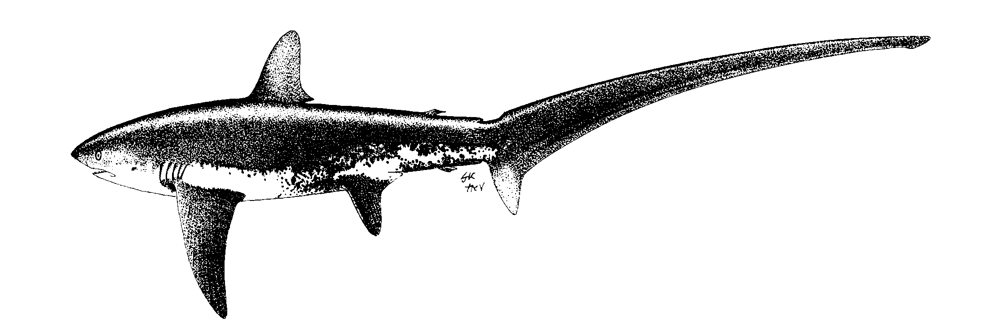
Name: Common Thresher Shark
Code: ALV
White colour of belly comes above pectoral fins
Distinctive white colour around the belly

Slide 21
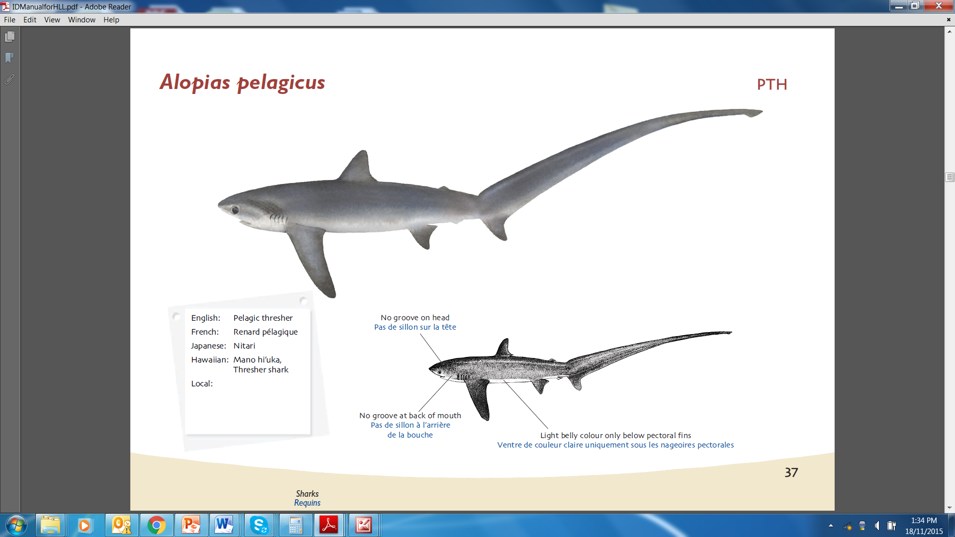

Slide 22
Note: Pelagic Thresher shark does not have the groove on the head and the distinctive
white marking around the belly like bigeye and common Thresher shark
Name: Pelagic Thresher Shark
Code: PTH

Slide 23
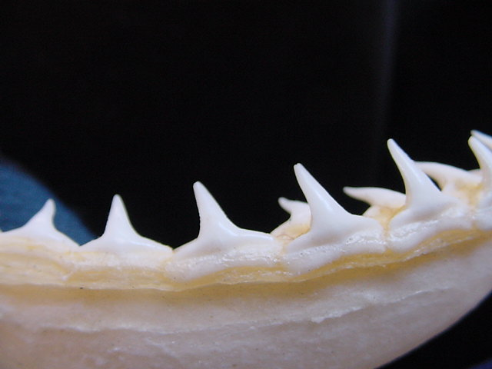
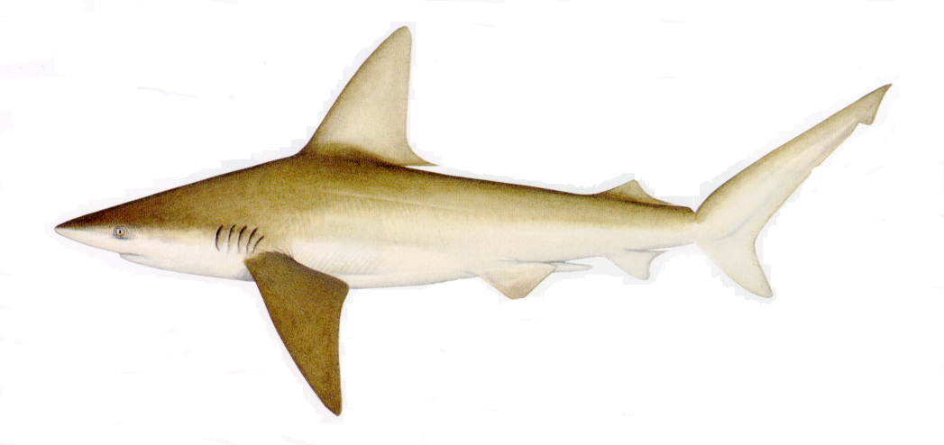
Name: Sandbar Shark
Code: CCP
1st dorsal fin
very large
Front of 1st dorsal fin is nearer the back of where the pectoral fin joins the body

Slide 26
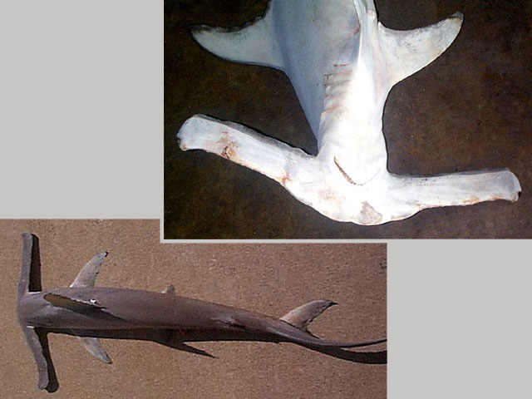
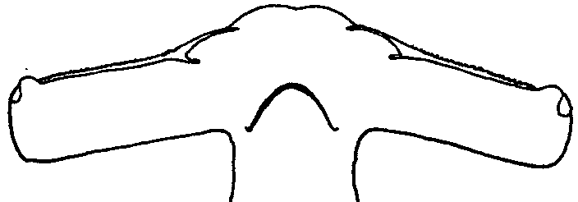
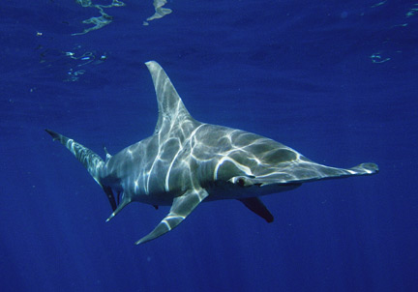
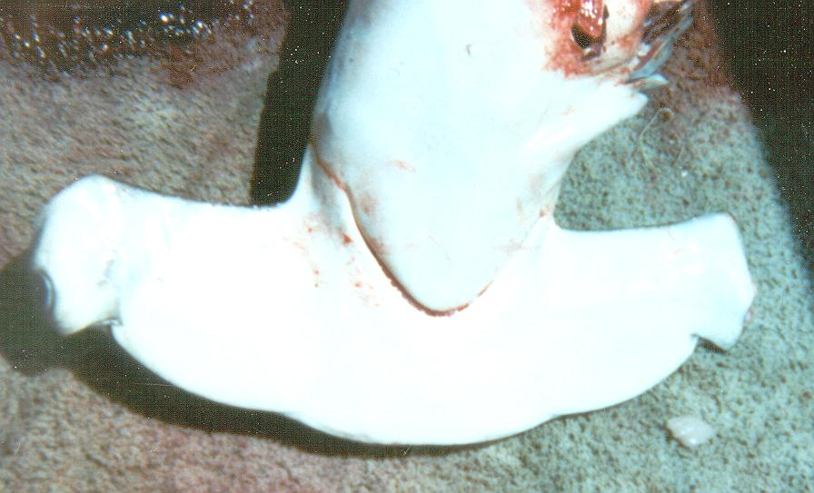
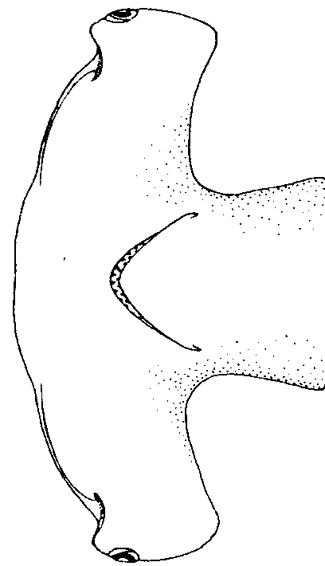
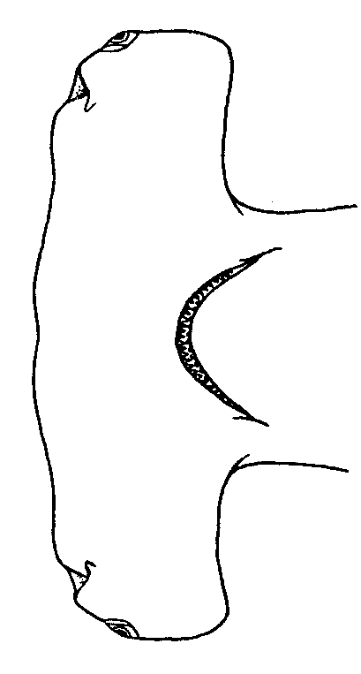
2
3
4
Wings of head
are long and narrow
1
Front of head
has 4 curves with dent
in the center
Winghead
CODE: EUB
Scalloped
CODE: SPL
1
3
2
Front of head is almost straight
Front of head has 3 curves
Smooth
CODE: SPZ
Great
CODE: SPK

Slide 31
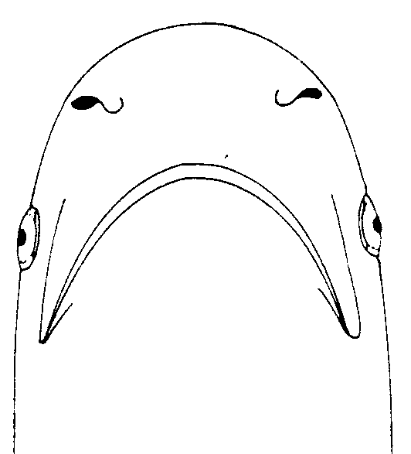
Shape of head is
round and blunt
Tiger stripes marking on the
body, faded in adults
Name: Tiger shark
Code: TIG

Slide 33
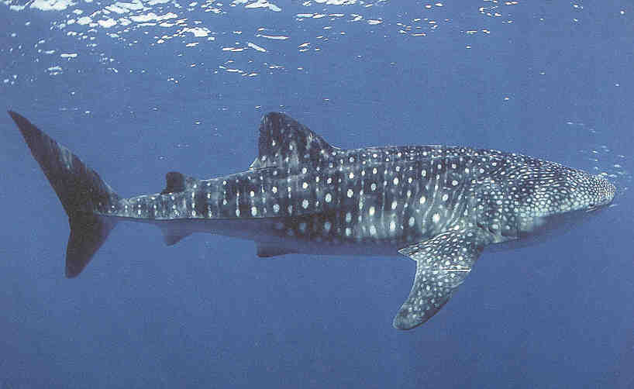
Name: Whale Shark
Code: RHN

Slide 36
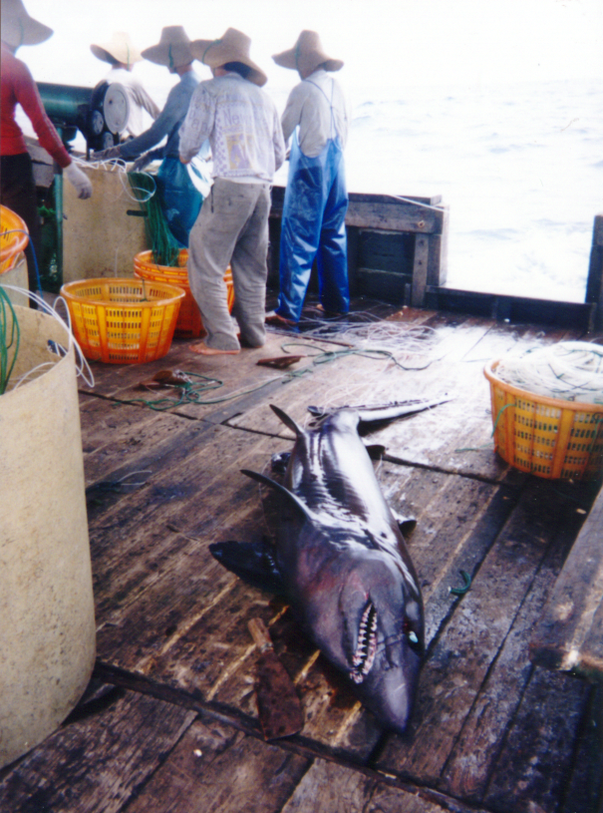

Slide 37
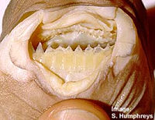
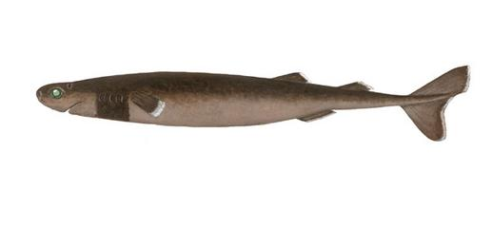
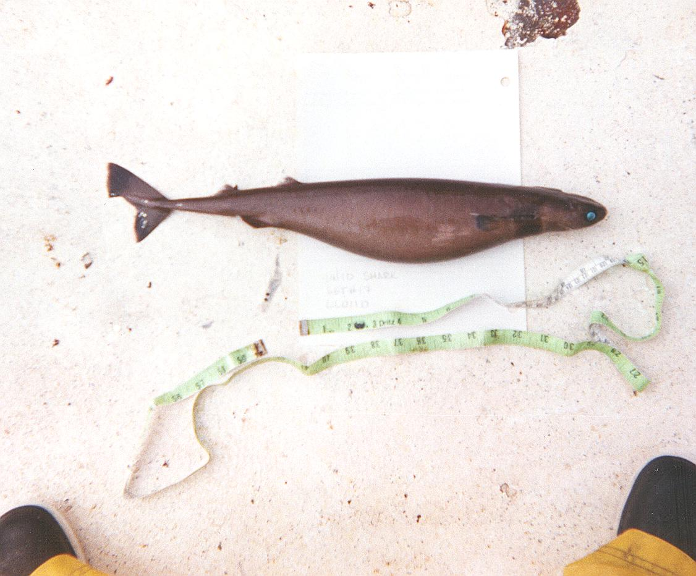
Name: Cookie Cutter shark
Code: ISB
The Cookie-cutter Shark is named
after the neat cookie-shaped
wounds that it leaves on the
bodies of larger fishes (tuna, marlin etc
No anal fin
First dorsal fin way back
Dark ring near gills

Slide 41
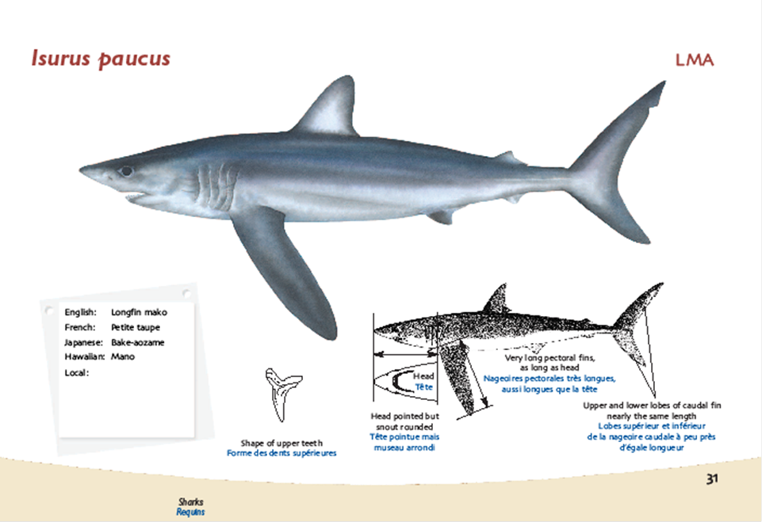
Compare sharks

Slide 42
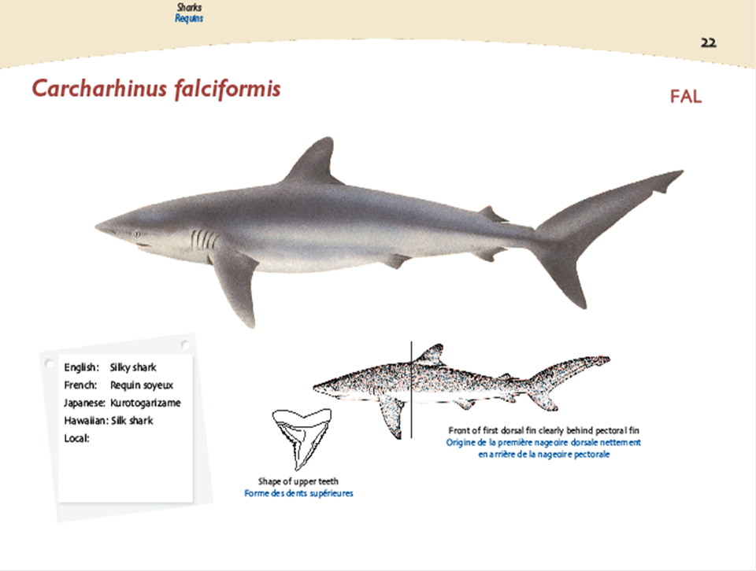
Compare sharks

Slide 43
Compare sharks

Slide 44
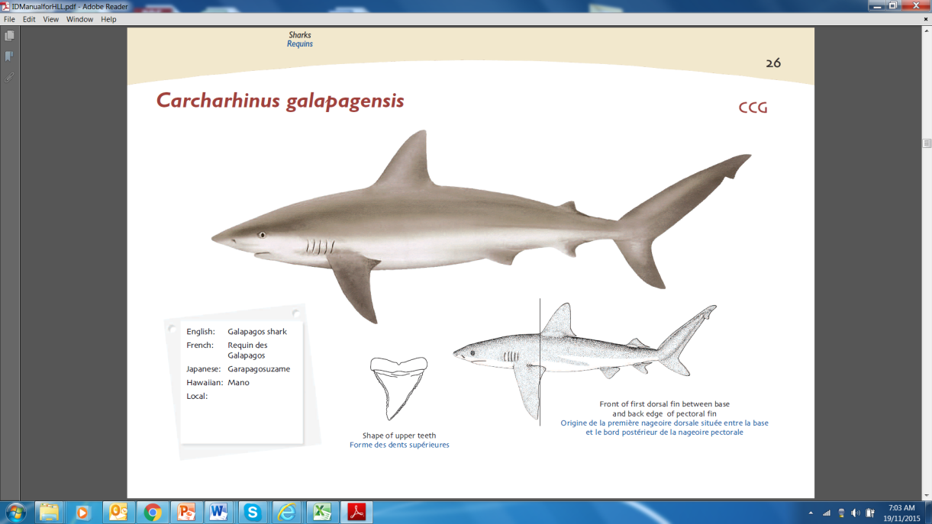
Compare sharks

Slide 45
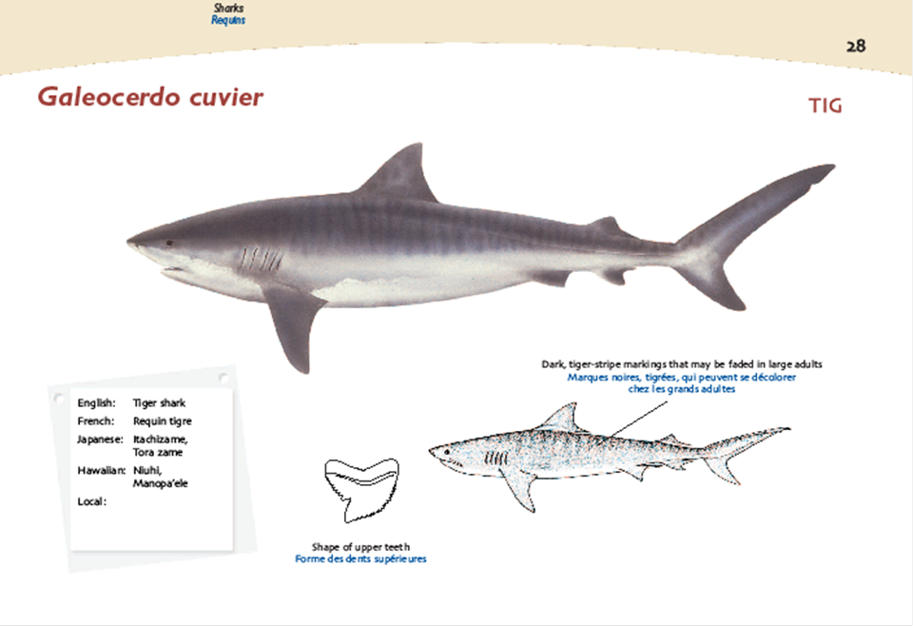
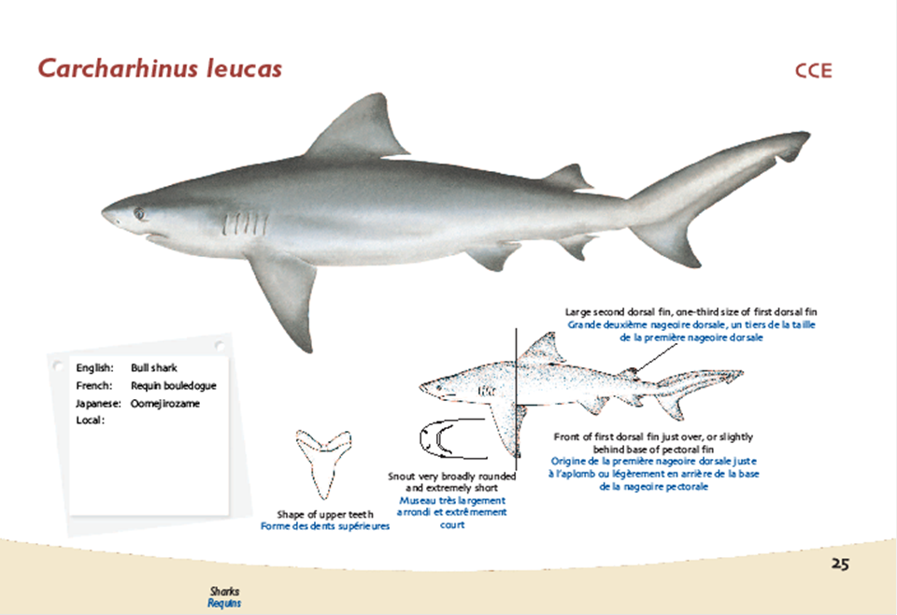
Compare sharks

Slide 46
Compare sharks

Slide 47
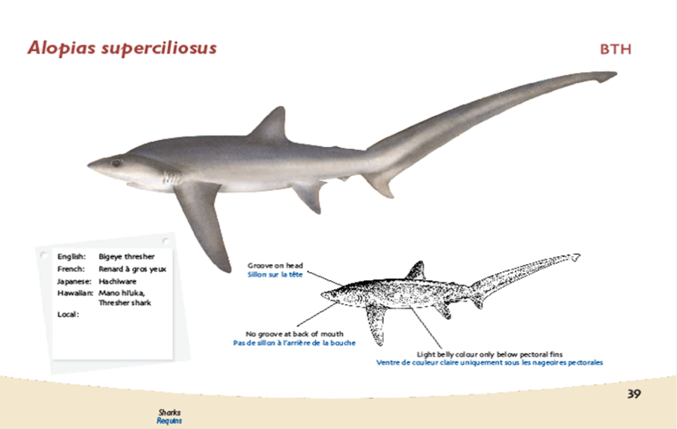
Compare sharks

