Slide 1
LATITUDE / LONGITUDE
To determine our position we use imaginary
PARALLEL lines,
and MERIDIAN lines
Parallels of
Latitude
Meridians of
Longitude
Notes:
Parallel lines are evenly spaced
Meridian lines meet at a point

Slide 2
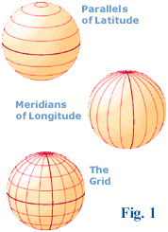
fig. 1
fig. 2
fig. 3

Slide 3
All these lines together provide the GRID (fig 3) which enables us to describe any position
in Latitude and in Longitude
fig. 3

Slide 4
The equator (00 ° of latitude) divides the earth into the North and South Hemispheres
North
pole
90°N
Northern hemisphere
Southern hemisphere
South
pole
90°S
The North Pole has a latitude of 90°N
The South Pole has a latitude of 90°S

Slide 5
The prime meridian or Greenwich meridian (000° of longitude)
Joins the International date line on the other side of the earth (our side) to separate the
Western and Eastern hemispheres
prime meridian
Eastern hemisphere
180°
date line
Western hemisphere

Slide 6
Meridians (longitude) start at 000° and run east and west to 180°
100°W
140°E
120°E
120°W
Eastern hemisphere
160°E
160°W
Western hemisphere
100°E
140°W
180°
date line
In the Pacific we see longitude 100°E-180° and 180°-100°W

Slide 7
Latitude lines
run parallel
with each other
(equal distance apart) and never meet.
This is
Important
information
Longitude lines
get closer and closer
until they
meet at the poles

Slide 8
SUMMARY
Parallels of latitude
circle the globe parallel to the equator
range from 00°-90°N and 00°-90°S
Meridians of longitude
half-circles meet at north and south poles
range east from 000°-180°; and
range west from 000°-180°

Slide 9
SUMMARY contd
Date Line: starts at end of prime meridian at North Pole, ends at the other end of prime meridian at South Pole
The hour and date change at the date line
Latitude: defined by the number of degrees there are North or South of the equator, varies from 00° to 90°
Longitude: defined by the number of degrees east or west of prime meridian, varies from 000° to 180°
Position: is always recorded by writing the latitude first and the longitude second

Slide 10
NORTH
04
04
03
03
02
02
01
01
00
00
EQUATOR
01
01
N
W
E
02
02
S
03
03
04
04
05
05
SOUTH

Slide 11
INTERNATIONAL DATE LINE
180
04
04
03
03
02
02
01
01
00
00
EQUATOR
01
01
N
W
E
02
02
S
03
03
04
04
05
05
180

Slide 12
175E
176E
177E
178E
179E
180
04
04
03
03
02
02
01
01
00
00
01
01
N
W
E
02
02
S
03
03
04
04
05
05
175E
176E
177E
178E
179E
180

Slide 13
180
179W
178W
177W
176W
04
04
03
03
02
02
01
01
00
00
01
01
N
W
E
02
02
S
03
03
04
04
05
05
180
179W
177W
176W
178W

Slide 14
175E
176E
177E
178E
179E
180
179W
178W
177W
176W
04
04
03
03
02
02
01
1
00
00
01
01
N
W
E
02
02
S
03
03
04
04
05
05
175E
176E
177E
178E
179E
180
179W
177W
176W
178W

Slide 15
175E
176E
177E
178E
179E
180
179W
178W
177W
176W
04
04
.
03
03
02°00’N 178° 00’E
02
02
01
01
00
00
01
01
N
W
E
02
02
S
03
03
04
04
05
05
175E
176E
177E
178E
179E
180
179W
177W
176W
178W

Slide 16
175E
176E
177E
178E
179E
180
179W
178W
177W
176W
04
04
03
03
02
02
.
01
01
00
00
00°00’ 179° 00’E
01
01
N
W
E
02
02
S
03
03
04
04
05
05
175E
176E
177E
178E
179E
180
179W
177W
176W
178W

Slide 17
175
176
177
178
179
180
179
178
177
176
04
04
03
03
02
02
01
01
00
00
01
01
N
.
W
E
02
02
03° 00’S 179°00’W
S
03
03
04
04
05
05
175
176
177
178
179
180
179
177
176
178

Slide 18
175E
176E
177E
178E
179E
180
179W
178W
177W
176W
 |  | •
04
04
.
03°00’N 177° 00’W
03
03
02
02
01
01
00° 00’ 180° 00’
00
•
00
N
01
01
W
E
02
02
02° 30’S 176° 30’E
S
03
03
04
04
05
05
175E
176E
177E
178E
179E
180
179W
177W
176W
178W

Slide 19
Nautical mile: One nm is one minute (') of latitude on a chart or one minute of longitude only at the equator
1° Latitude = 60 nm
1 kt = 1 nautical mile per hour

Slide 20
175E
176E
177E
178E
179E
180
179W
178W
177W
176W
04
04
03
03
60 x 3 = 180 nm
1 degree of latitude = 60 nautical miles
02
02
01
01
00
00
01
01
N
W
E
02
02
S
03
B
03
A
04
04
Course
090°
05
05
175E
176E
177E
178E
179E
180
179W
177W
176W
178W

Slide 21
175E
176E
177E
178E
179E
180
179W
178W
177W
176W
04
04
03
03
02
.
02
Hook Is
01
01
Distance from
Observer Is.
to
Hook Is.
60 nM x 6
360 nM
00
00
01
01
N
W
E
02
02
S
03
.
03
04
04
05
Observer Is
05
175E
176E
177E
178E
179E
180
179W
177W
176W
178W

Slide 22
175E
176E
177E
178E
179E
180
179W
178W
177W
176W
04
04
COURSE
Observer Is.
to
Hook Is
270 + 45
315°
03
03
02
.
02
Hook Is
01
1
00
00
01
01
N
W
E
02
02
S
03
.
03
04
04
05
Observer Is
05
175E
176E
177E
178E
179E
180
179W
177W
176W
178W

Slide 23
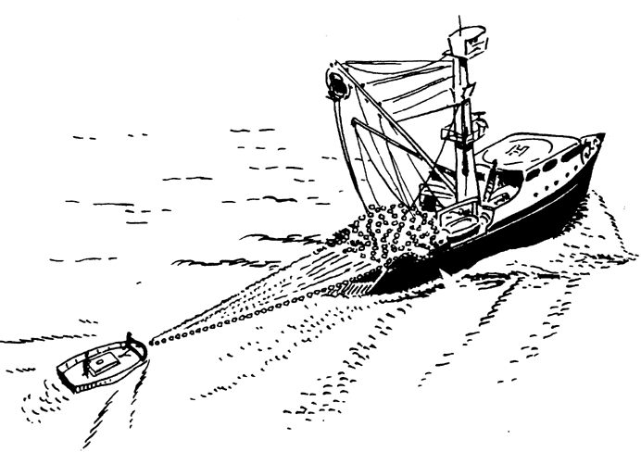
175E
176E
177E
178E
179E
180
179W
178W
177W
176W
4
4
3
3
Distance =
Time x Speed
D = T x S
T = D / S
S = D / T
2
.
2
Hook Is
1
1
0
0
1
1
N
W
E
2
2
S
3
.
3
4
4
5
Observer
5
175E
176E
177E
178E
179E
180
179W
177W
176W
178W

Slide 24
Distance = Speed x Time
D = S x T
S = D ÷ T
T = D ÷ S
Distance
Speed
Time

Slide 25
To measure distance at sea always use NAUTICAL MILES (nm)
This is determined as follows:
1° latitude = 60 minutes (60’)
1’ minute = 1 nautical mile (1 nm)
1° of latitude = 60 nm
Speed: is measured in nm per hour (nm/hr), which is more often called knots (kts).
… a vessel that is travelling at 7 nm/hr
is usually said to be doing 7 kts

Slide 26
175E
176E
177E
178E
179E
180
179W
178W
177W
176W
04
Vessel speed
10 knots
Distance
from Observer Is.,
to Hook Is,
360 nM
How long will it
take to travel
From Observer Is.,
to Hook Is. ?
03
.
02
Hook Is
01
00
N
01
W
E
02
S
.
03
04
Observer
05
175E
176E
177E
178E
179E
180
179W
177W
176W
178W

Slide 27
175E
176E
177E
178E
179E
180
179W
178W
177W
176W
04
Vessel speed
10 knots
Distance
from Observer Is.,
to Hook Is,
360 nM
How long will it
take to travel
From Observer Is.,
to Hook Is. ?
03
T = D ÷ S
T = 36 hours
.
02
Hook Is
01
00
N
01
W
E
02
S
.
03
04
Observer
05
175E
176E
177E
178E
179E
180
179W
177W
176W
178W

Slide 28
175E
176E
177E
178E
179E
180
179W
178W
177W
176W
D = T X S
T = D/S
T = 360 NM
4
4
3
VESSEL SPEED
10 KNOTS/HOUR
DISTANCE FROM
OBSERVER IS TO
HOOK IS
360 NM
HOW LONG WILL
TAKE TO TRAVEL
FROM OBSERVER
TO HOOK IS?
3
2
.
2
HOOK IS
1
1
0
0
10 KNOTS/HR
1
1
N
= 36 HOURS
W
E
2
2
S
3
.
3
4
4
5
OBSERVER
IS
5
175E
176E
177E
178E
179E
180
179W
177W
176W
178W

