Slide 1
Korean Long liner

Slide 2
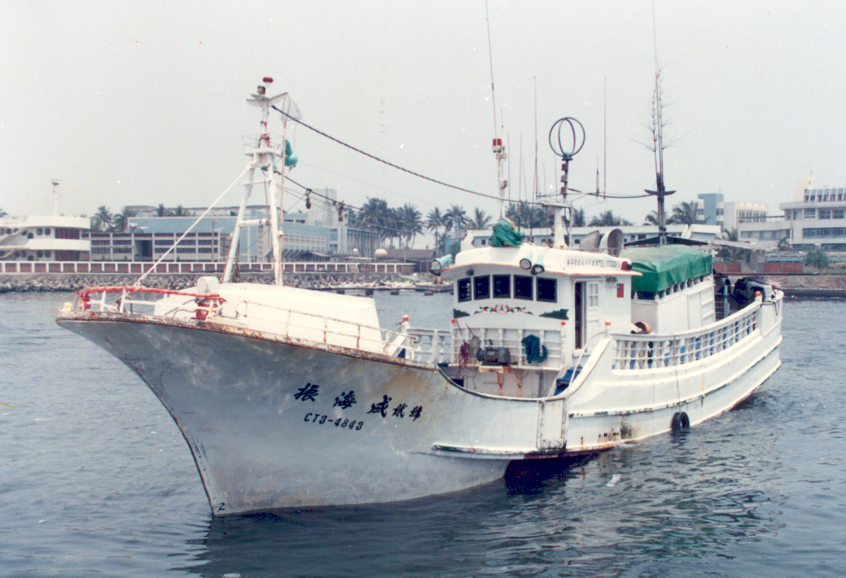
Chen Hai Cheng No 2 Taiwanese

Slide 3
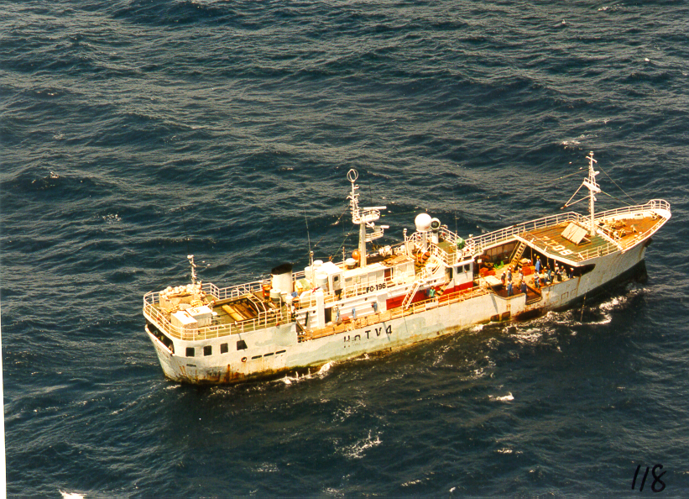
Korean Long liner, formerly a Japanese long liner.

Slide 4
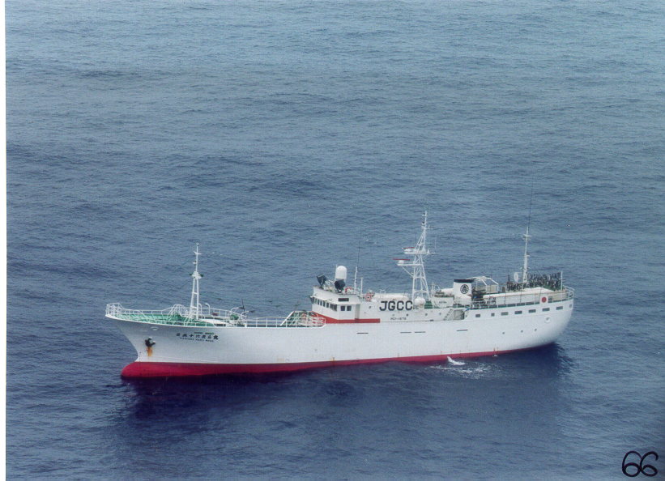
Japanese Long liner

Slide 5
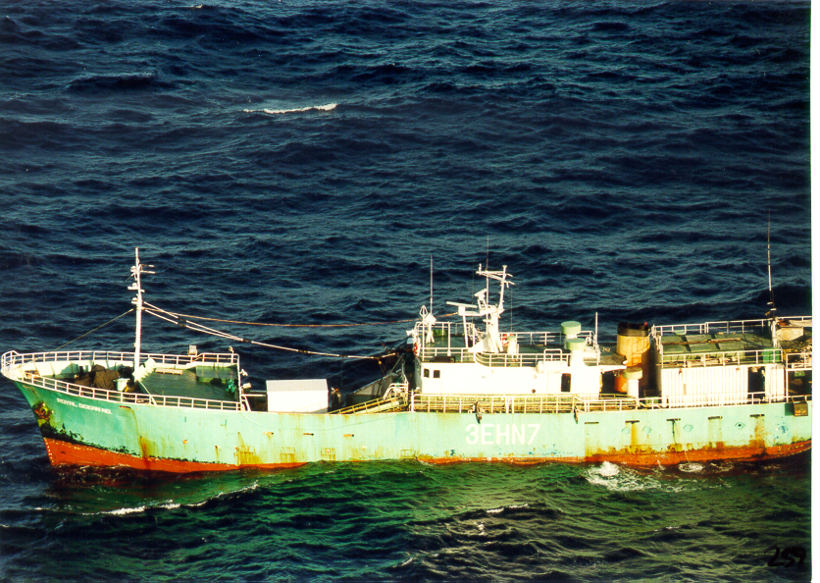
Korean Long liner

Slide 6
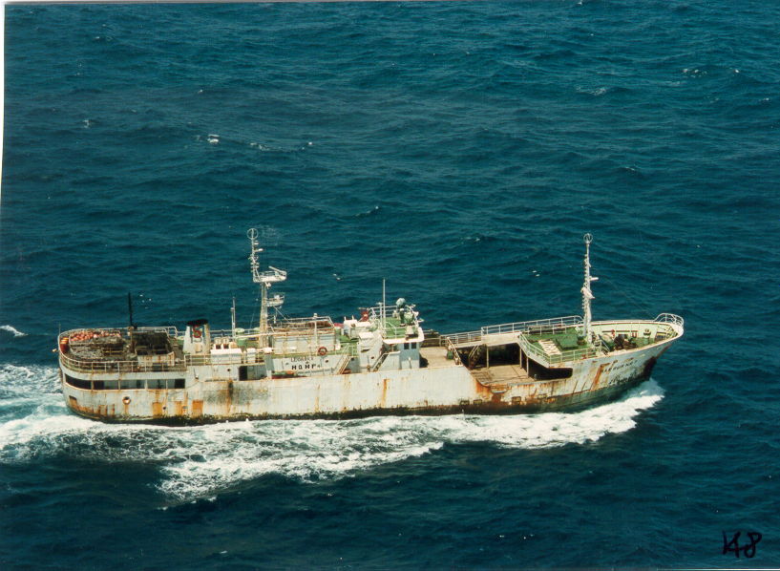
Korean Long Liner

Slide 7
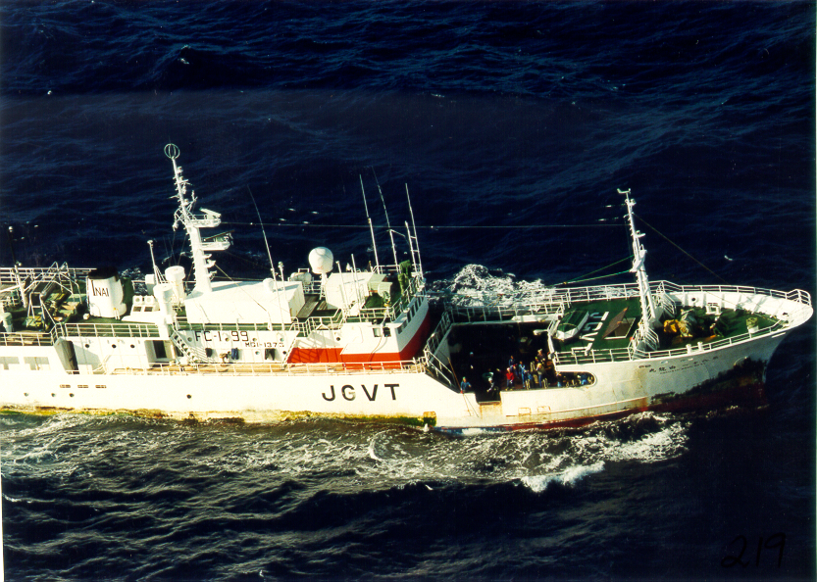
Japanese Long-Liner

Slide 8
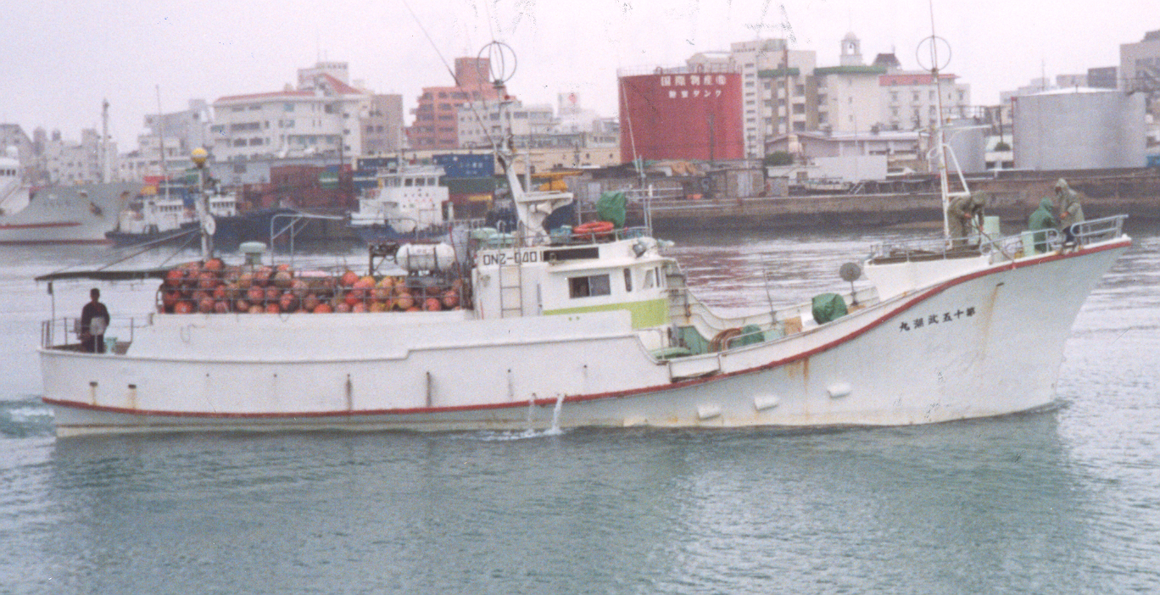
Small Japanese Long Liner

Slide 9
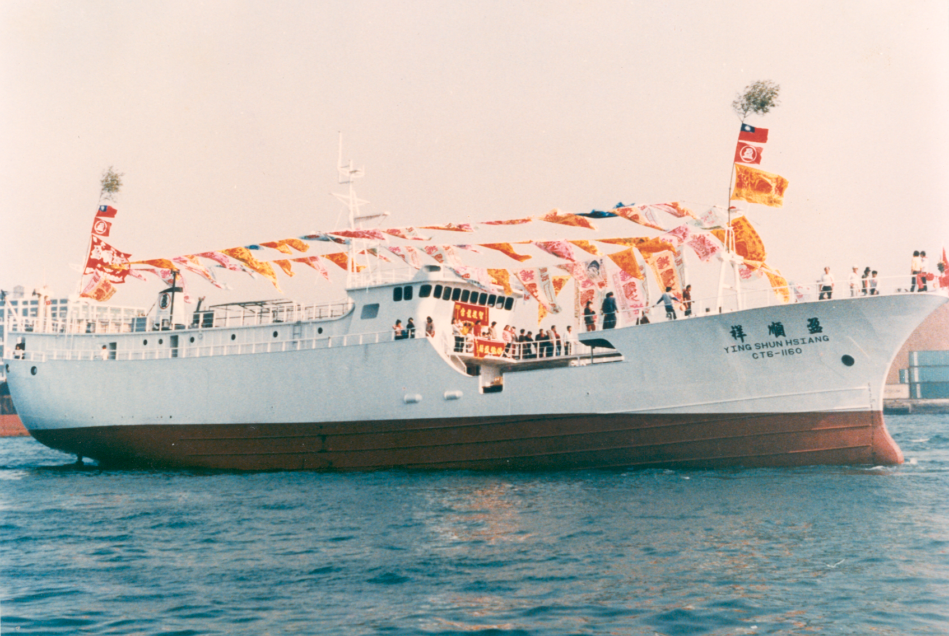
Taiwanese Long Liner

Slide 10
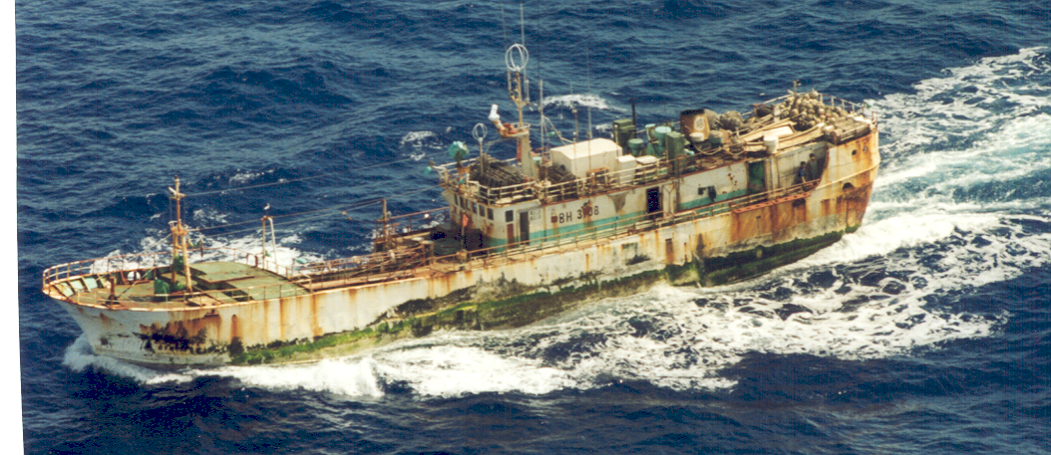
Nationality Unknown probably Taiwanese or Korean.

Slide 11
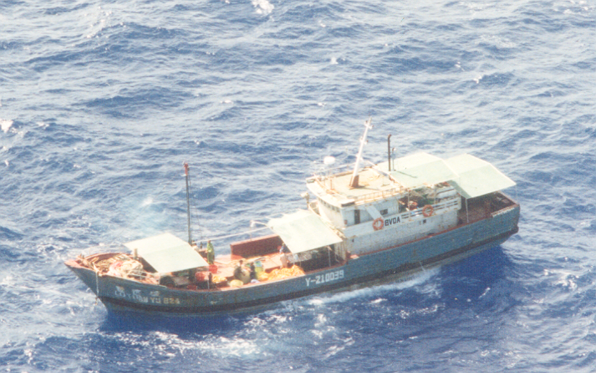
Mainland Chinese Long Liner

Slide 12
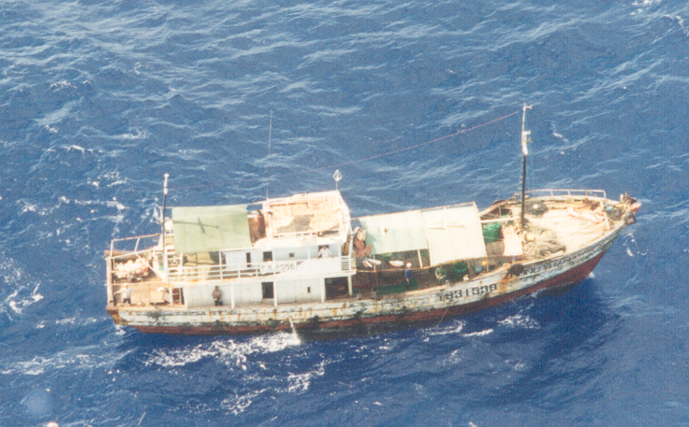
Mainland Chinese

Slide 13
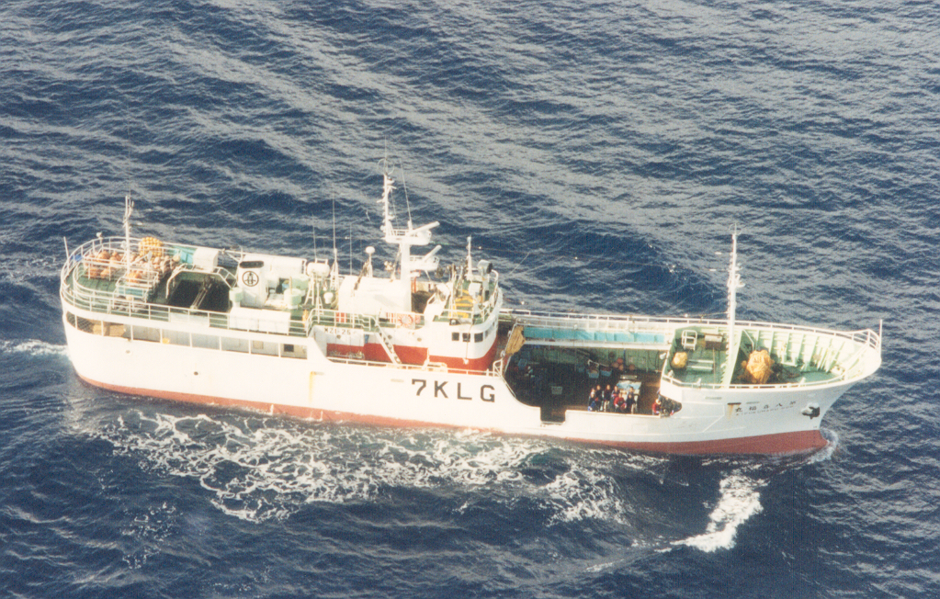
Japanese Long Liner

Slide 14
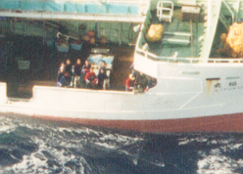
Note Hauling Mainline with branch line just about to be realeased from the mainline.

Slide 15
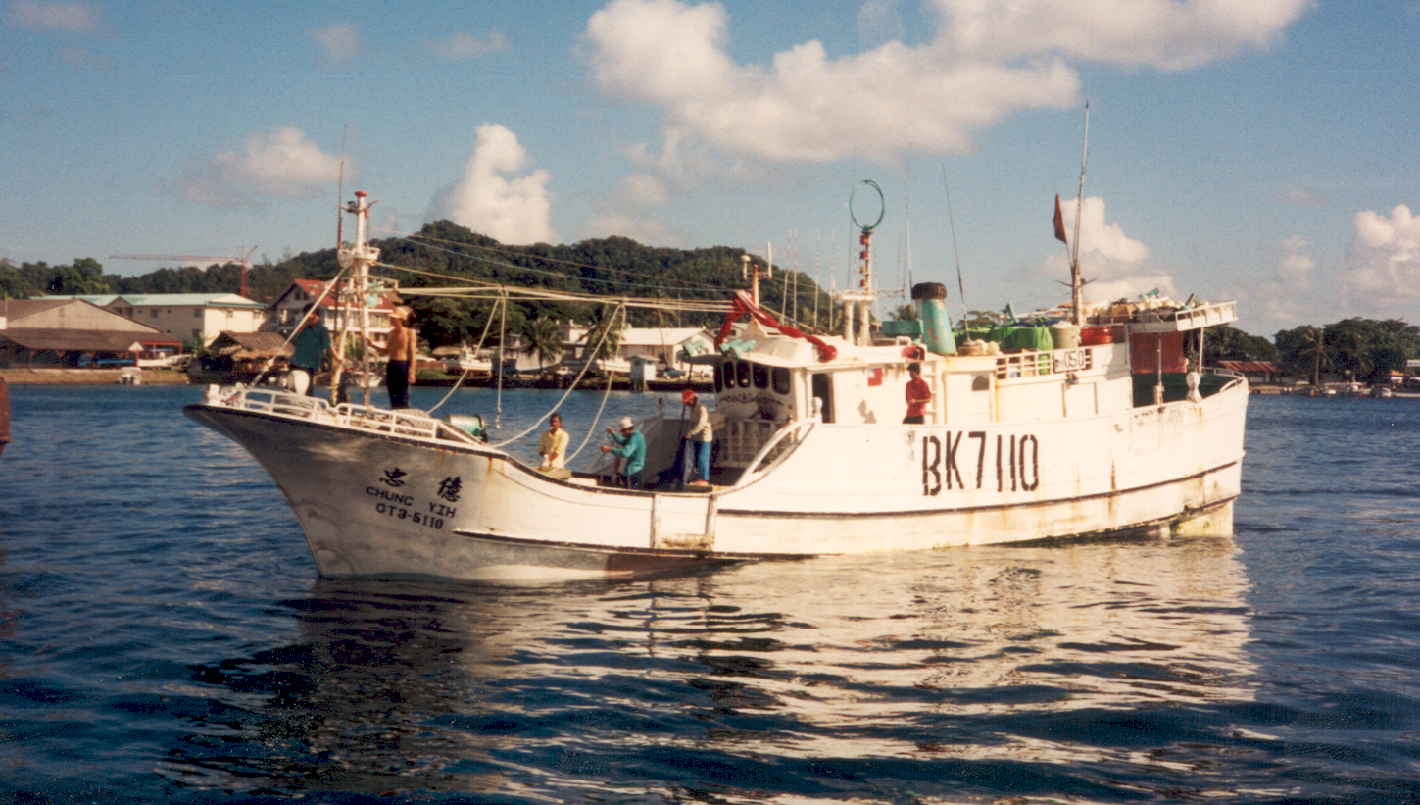
Taiwanese Banana Boat

Slide 16
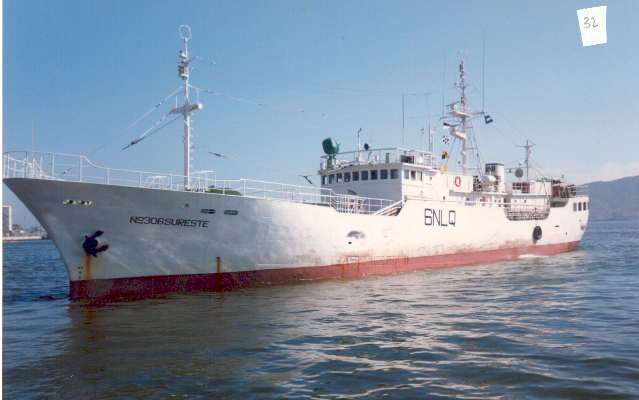
Korean Long Liner

Slide 17
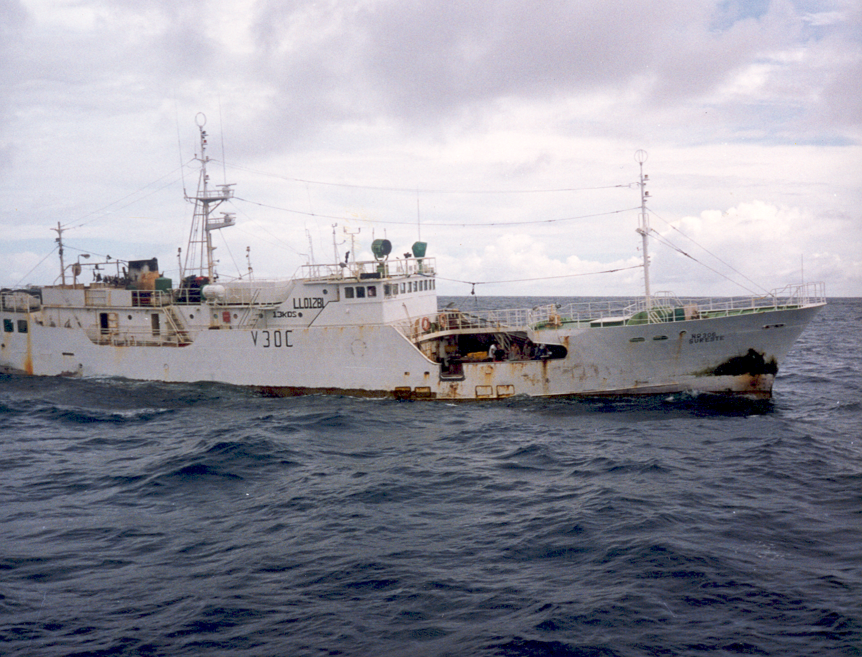
Korean Long Liner

Slide 18
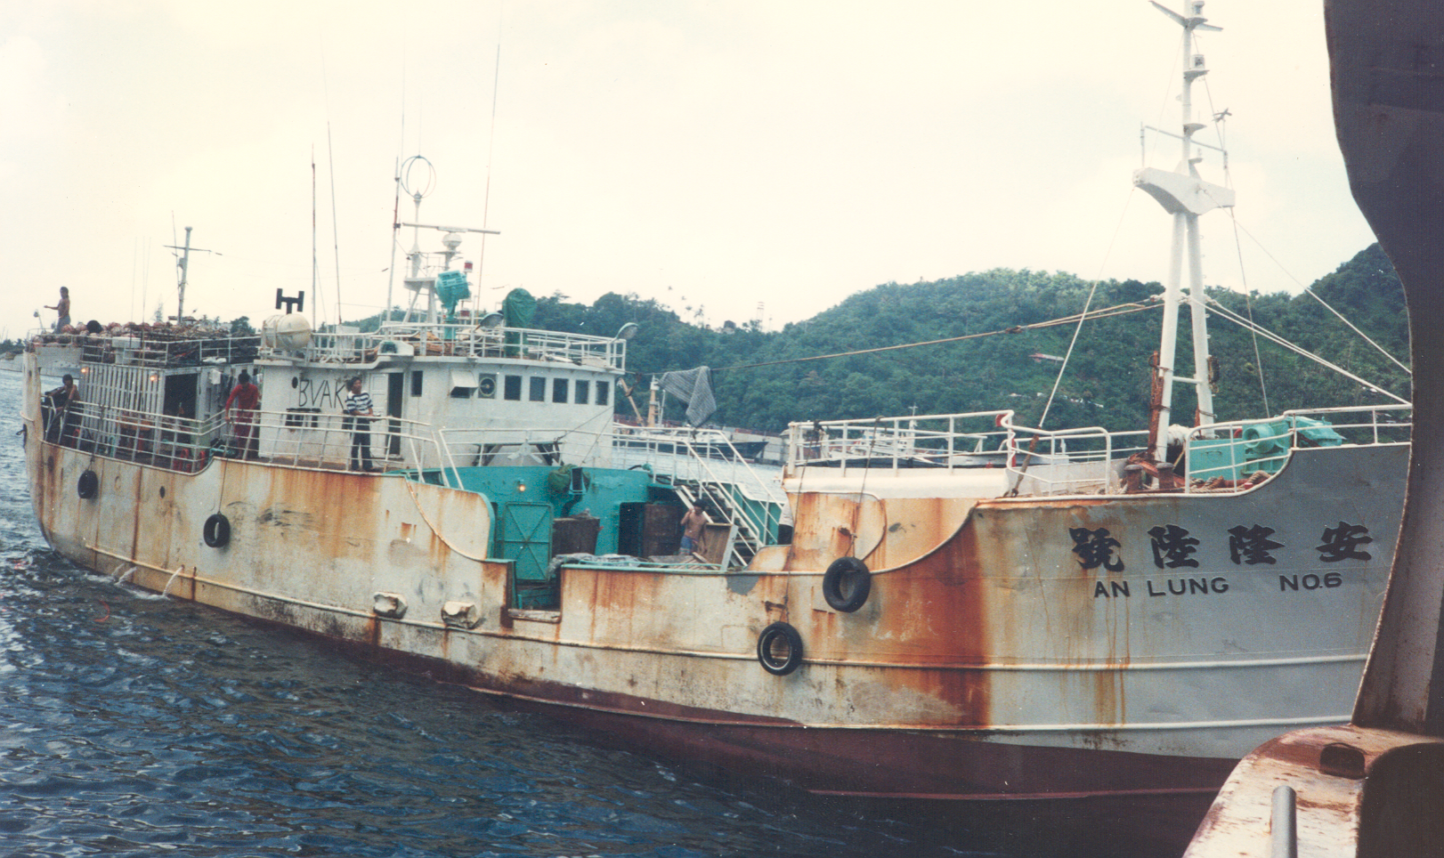
Taiwanese Long Liner

Slide 19
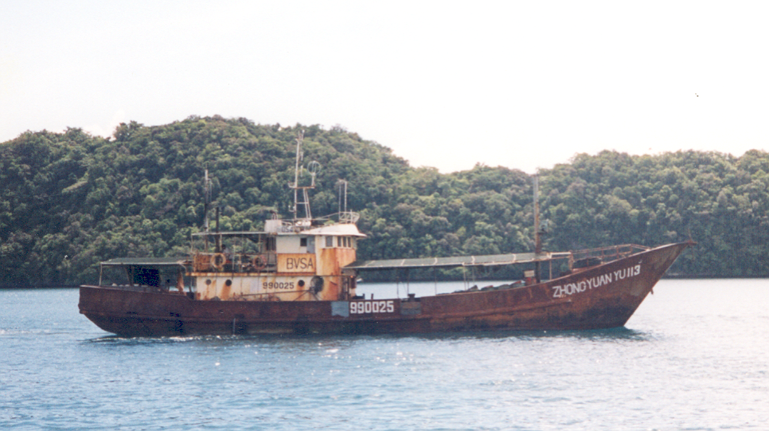
Mainland Chinese Vessel

Slide 20
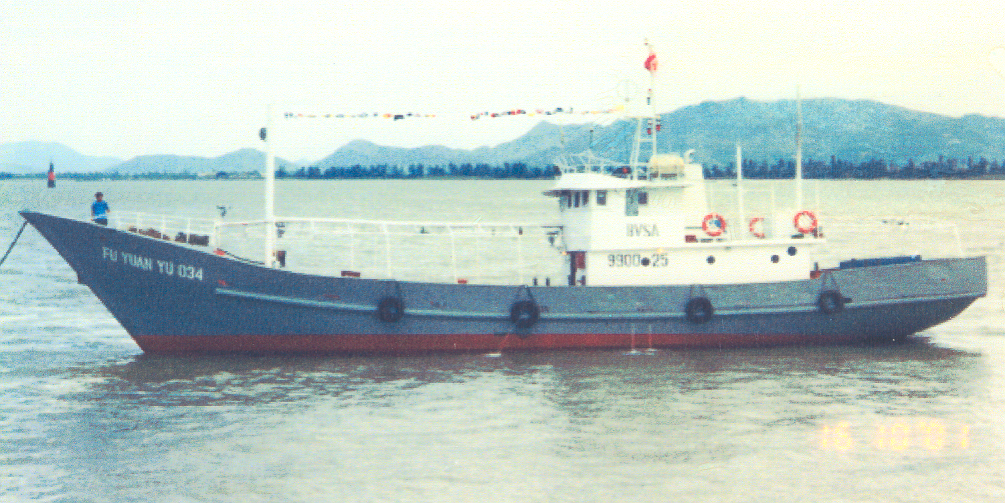
Mainland Chinese Long Liner

Slide 21
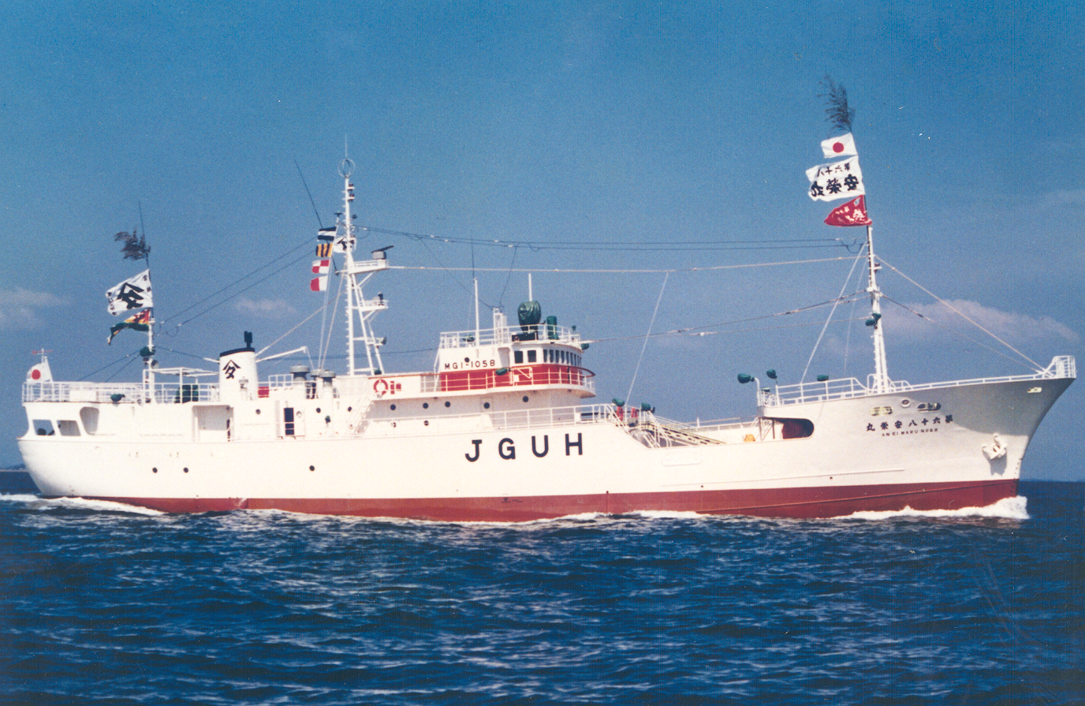
Japanese Long Liner

Slide 22
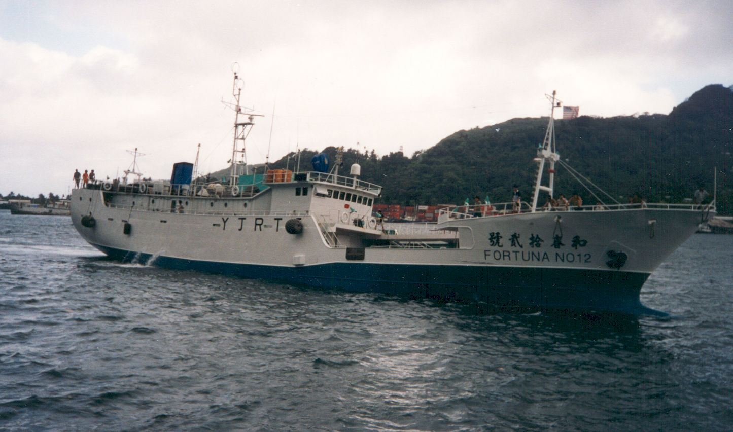
Taiwanese Long liner

Slide 23
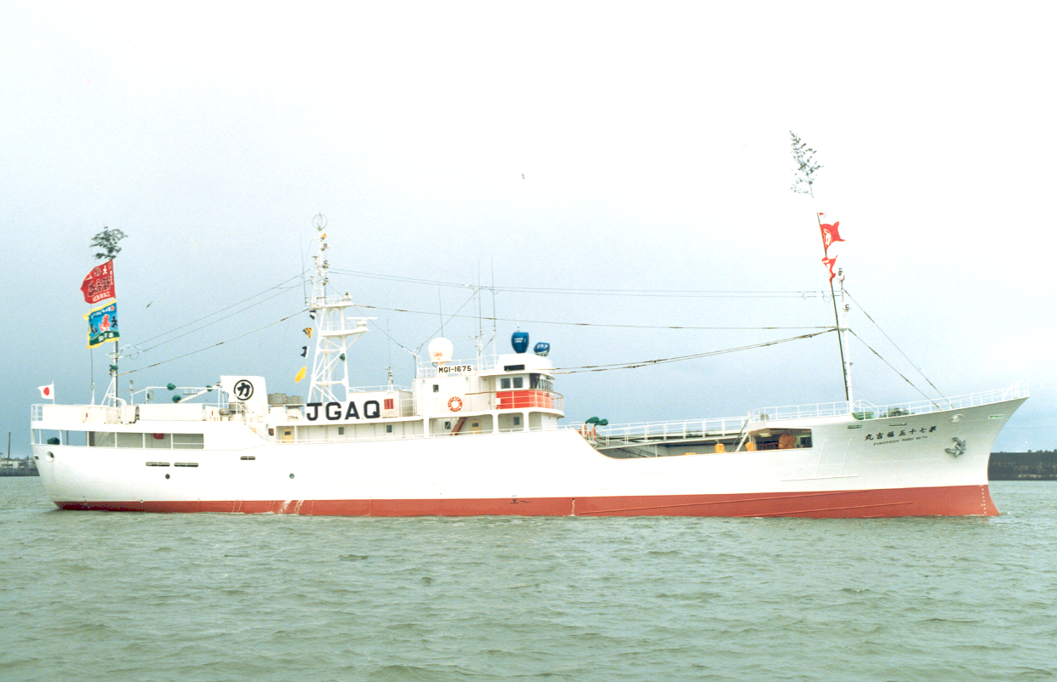
New Japanese Long Liner

Slide 24
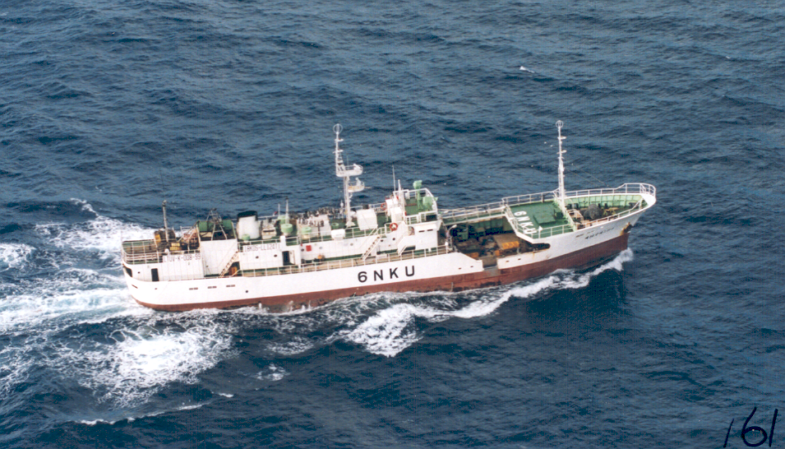
Korean Long Liner

Slide 25
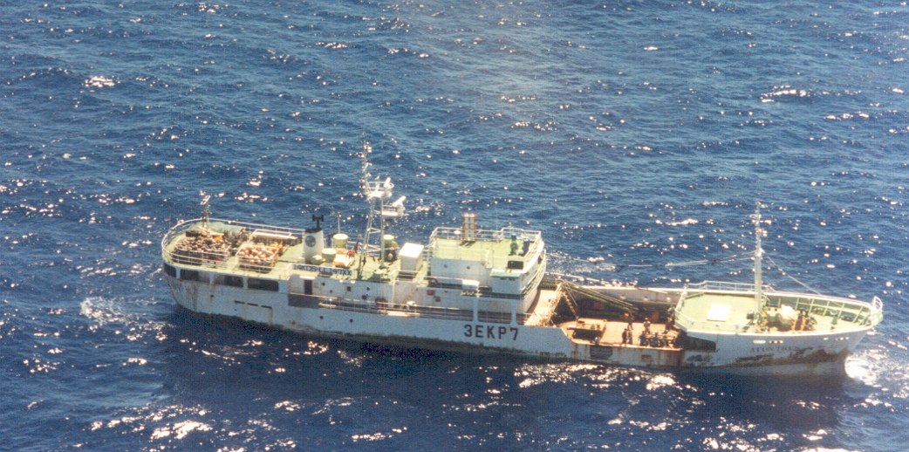
Korean Long Liner

Slide 26
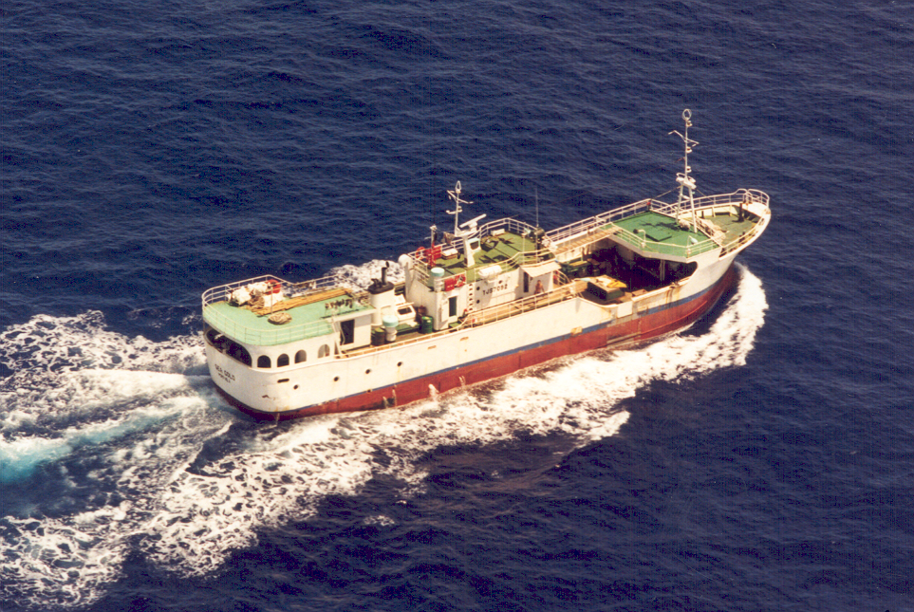
Philippine Long Liner

Slide 28
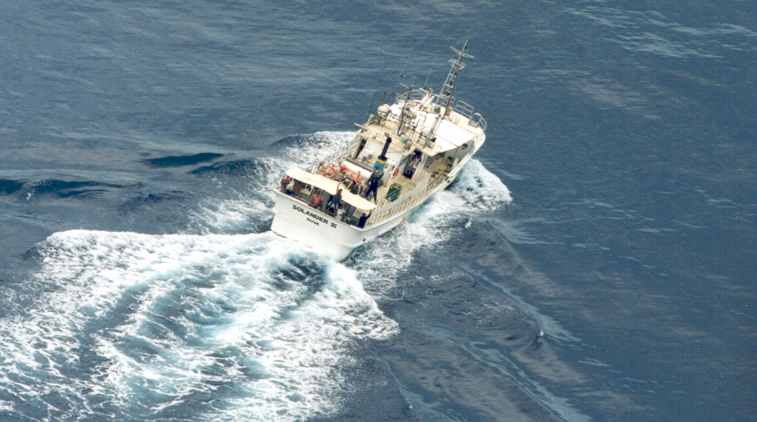
Mystery Vessel ?

Slide 29
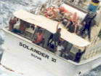
Photo blown up to identify the Vessel and Flag State?

Slide 30
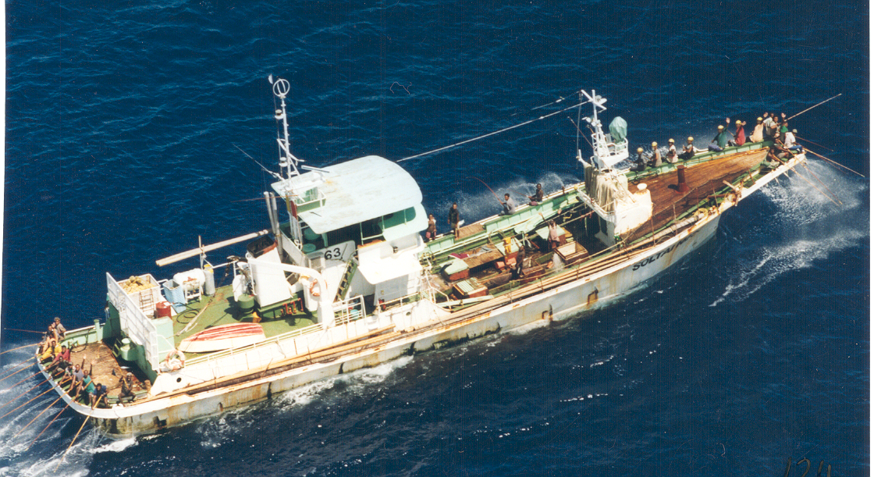
Solomon Island Pole and Line Vessel

Slide 31
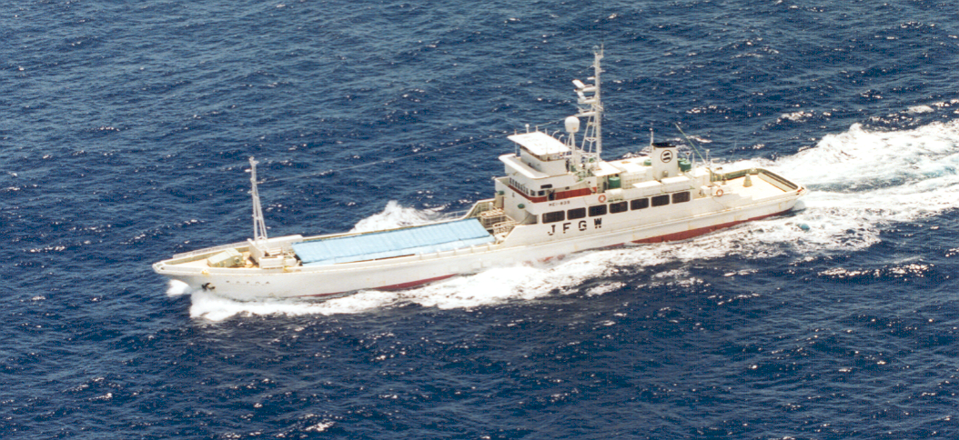
Japanese Pole and Line Vessel

Slide 32
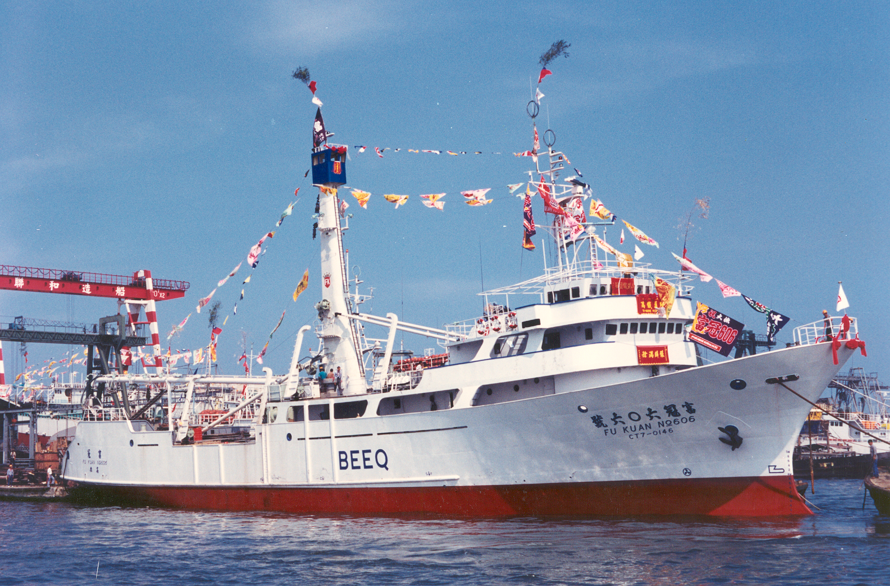
Taiwanese Purse Seiner

Slide 33
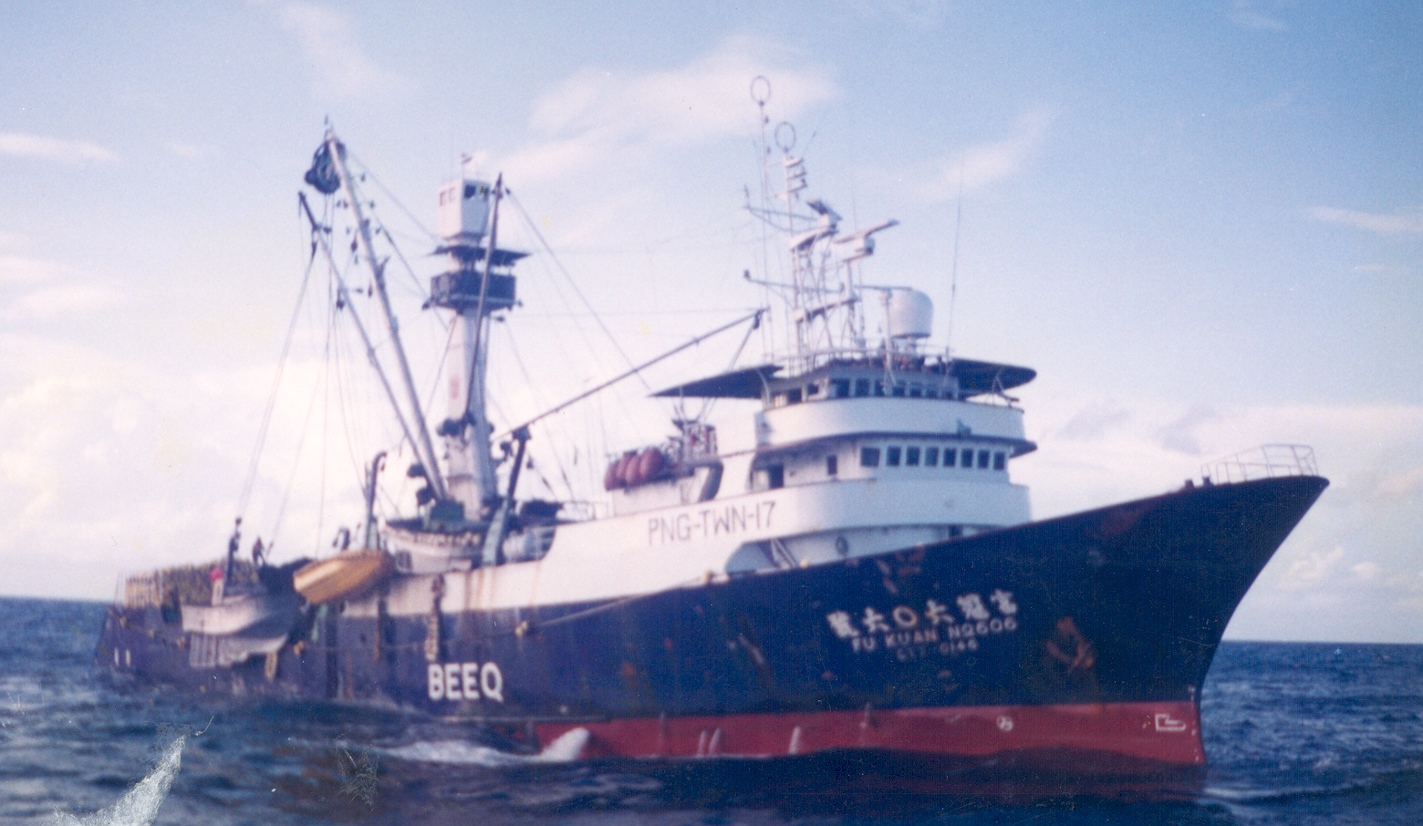
Taiwanese Purse Seiner

Slide 34
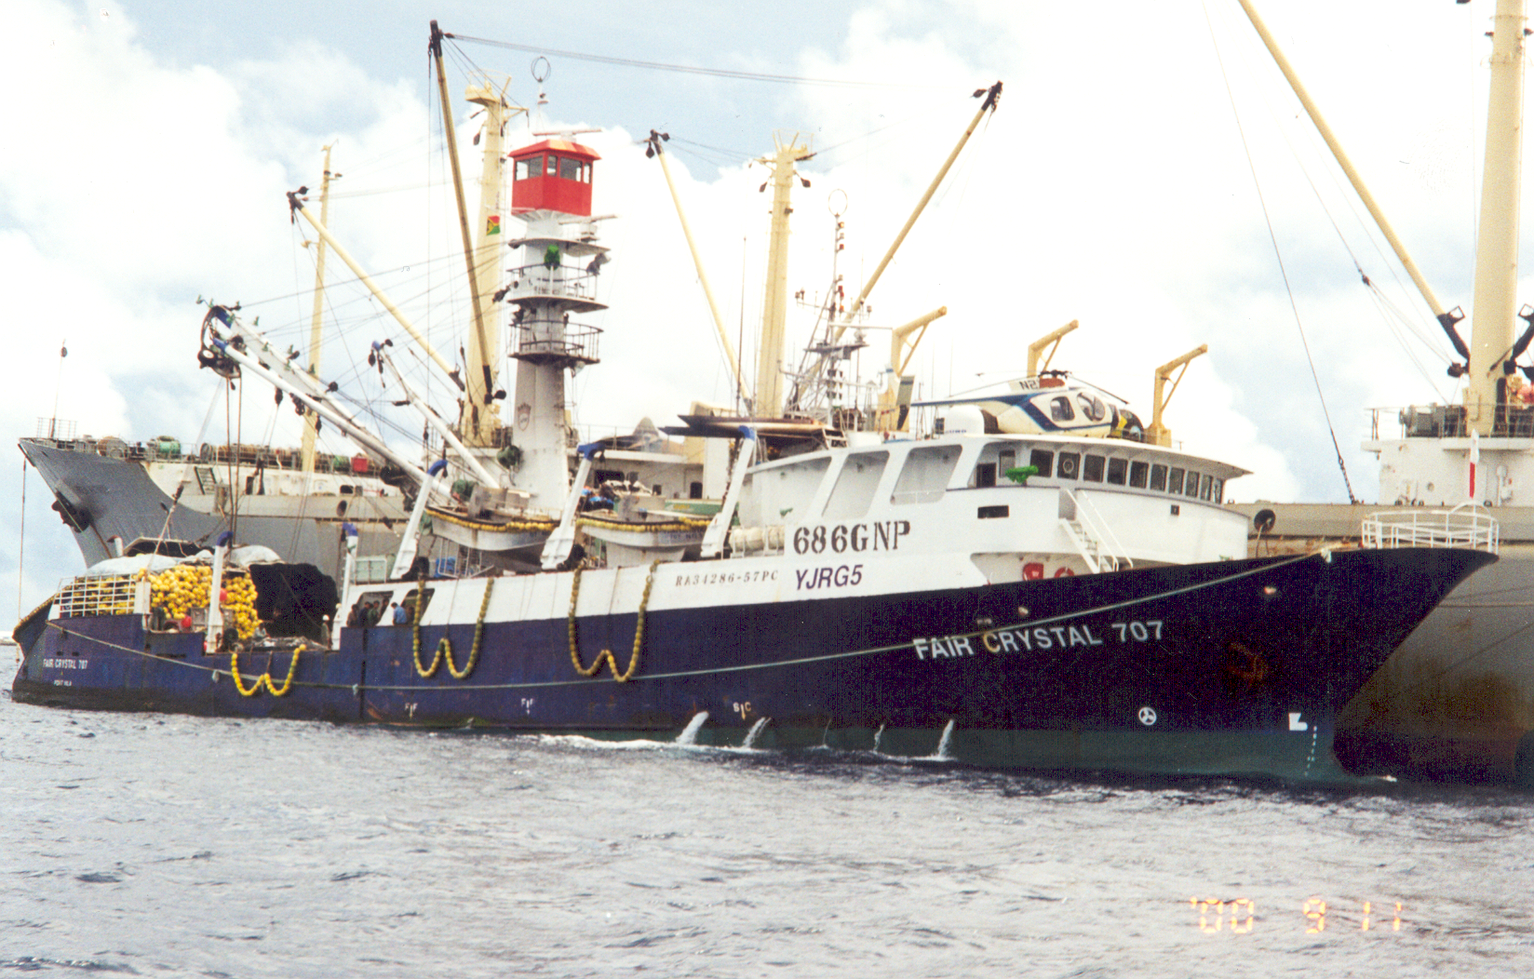
PNG/Taiwanese Purse-Seiner also FSM Arrangement Vessel

Slide 35
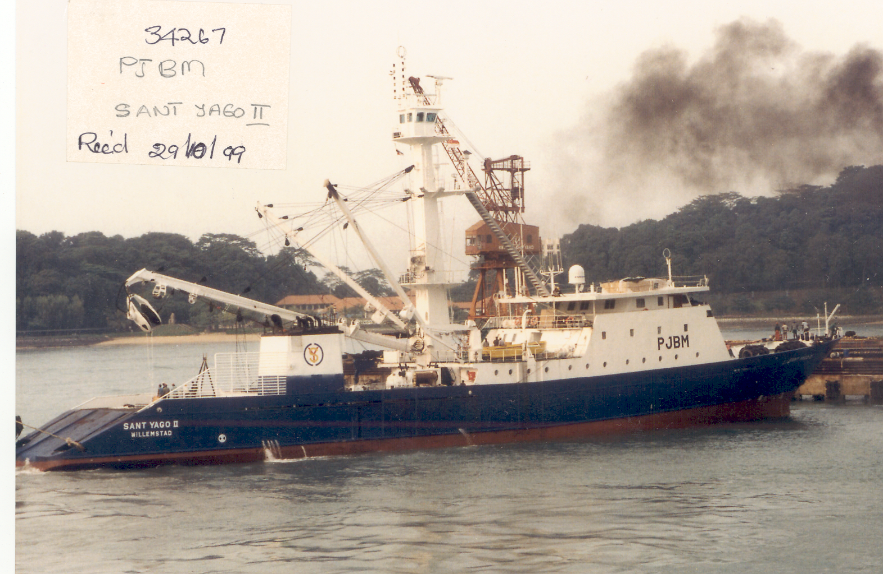
Spanish
Purse-Seiner
Registered Guatemala

Slide 36
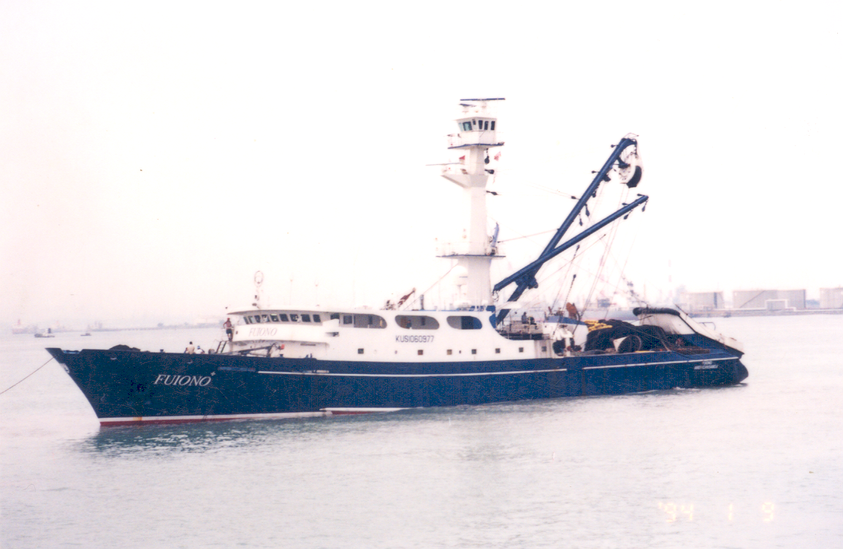
United States Purse-Seiner US treaty Vessel

Slide 37
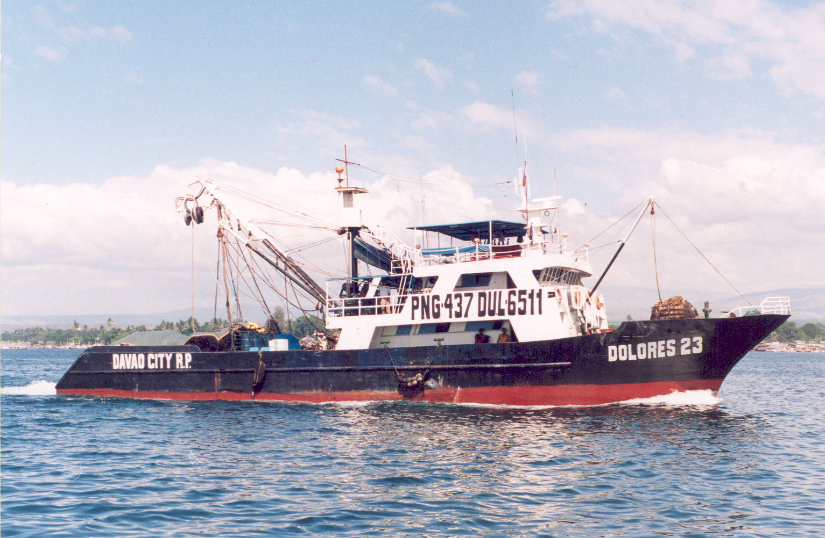
Philippine Purse Seiner

Slide 38
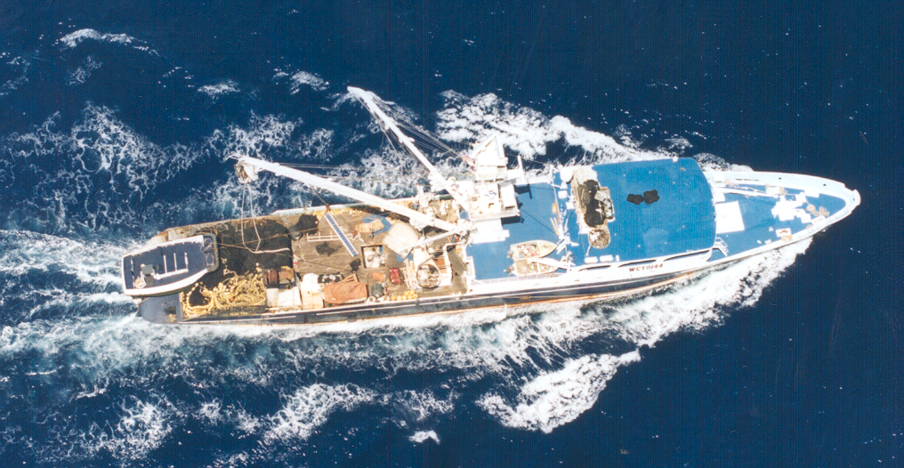
Top View of US Purse Seiner

Slide 39
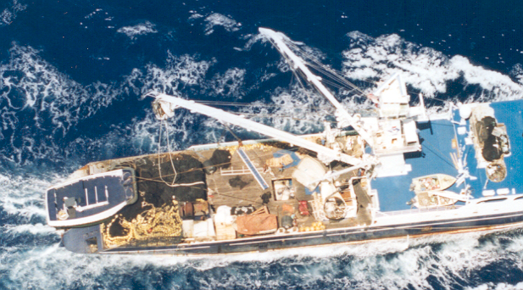
Net Skiff
Power Block
Speed Boats

Slide 40
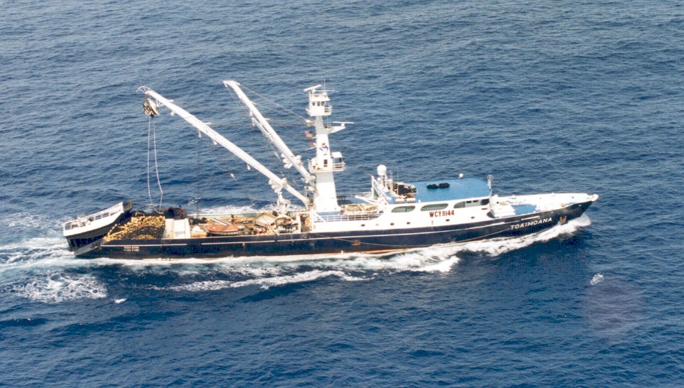
US Purse Seiner

Slide 41
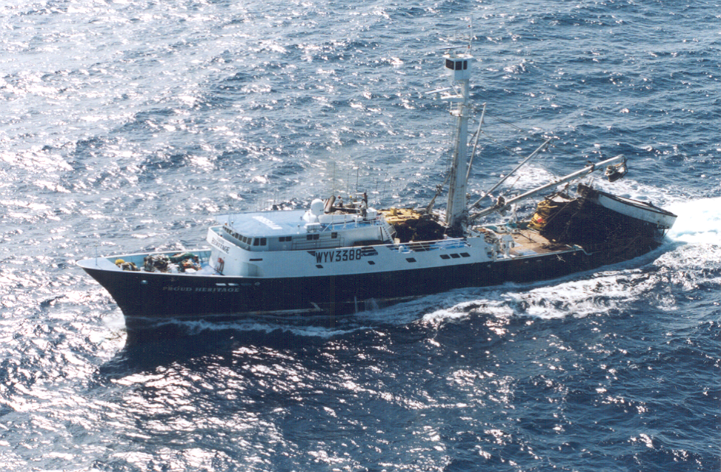
US Purse Seiner

Slide 42
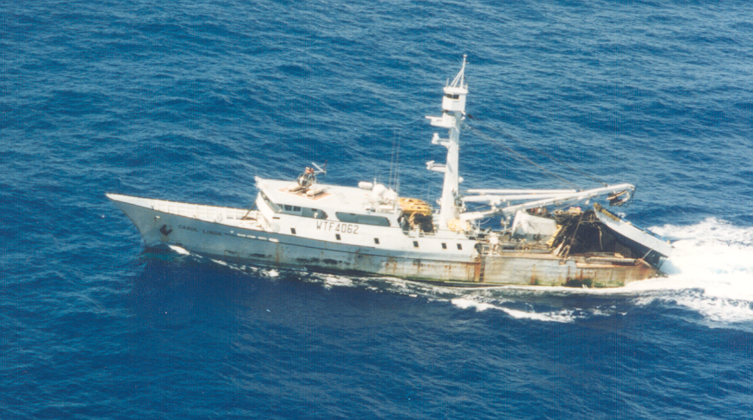
US Purse Seiner

Slide 43
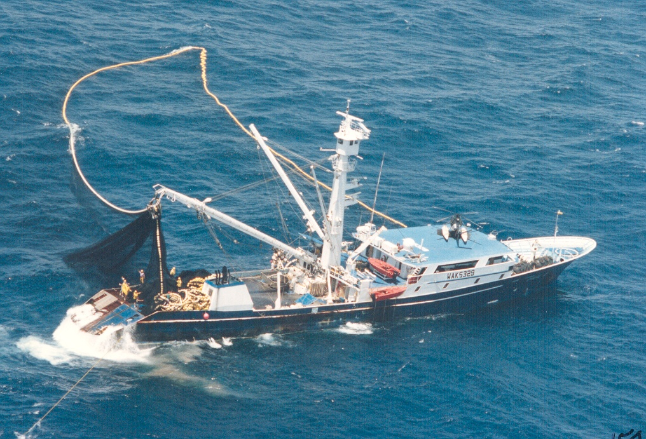
US Treaty Purse Seiner

Slide 44
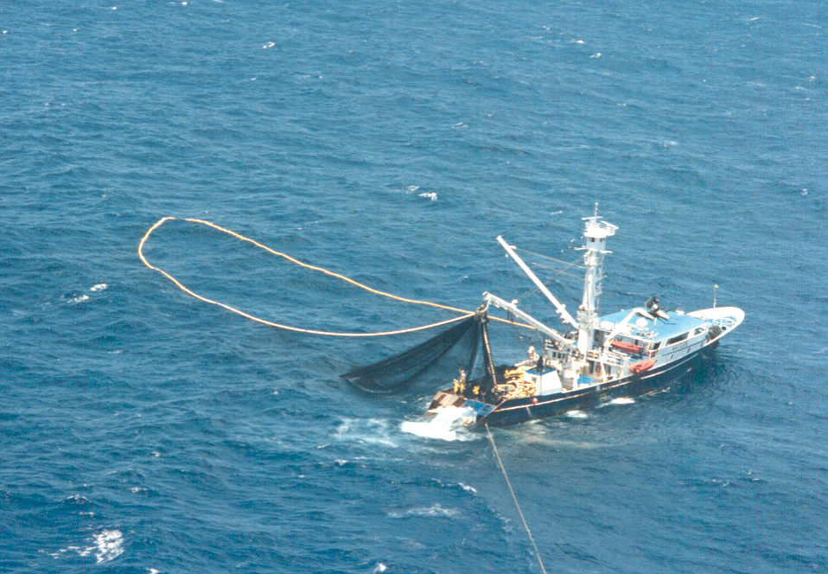
US Treaty Purse Seiner

Slide 45
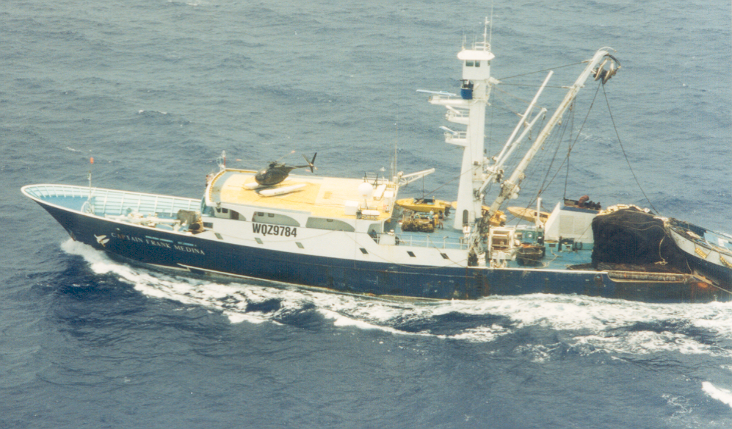
US Treaty Purse Seiner

Slide 46
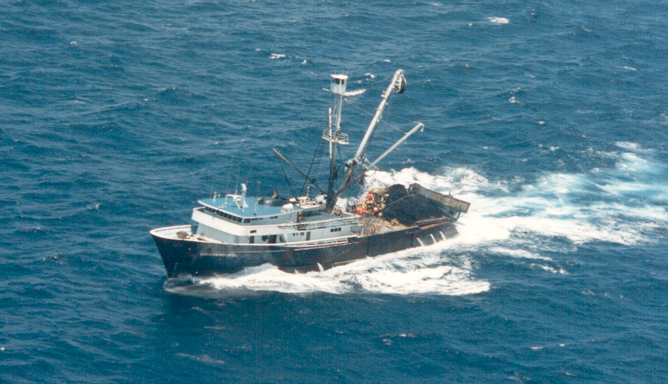
Korean Purse Seiner

Slide 47
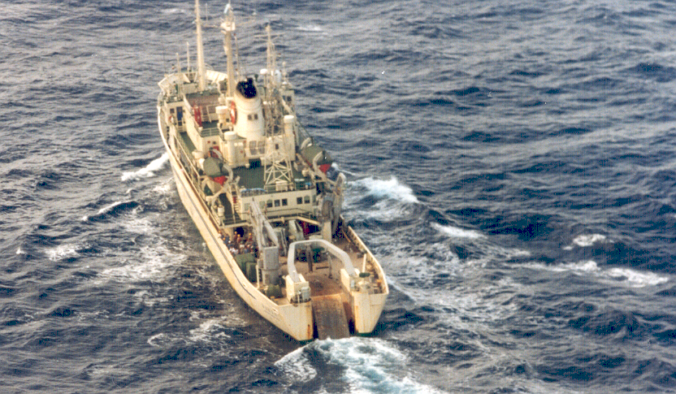
Japanese Research Vessel

Slide 48
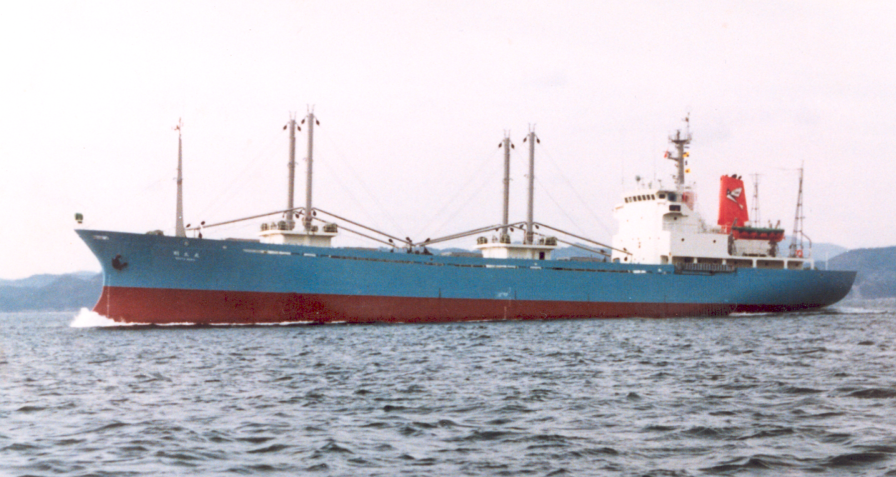
Fish Carrier

Slide 49
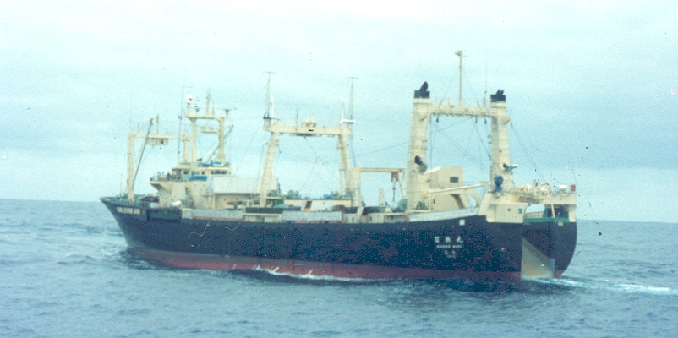
Whaling Vessel

Slide 50
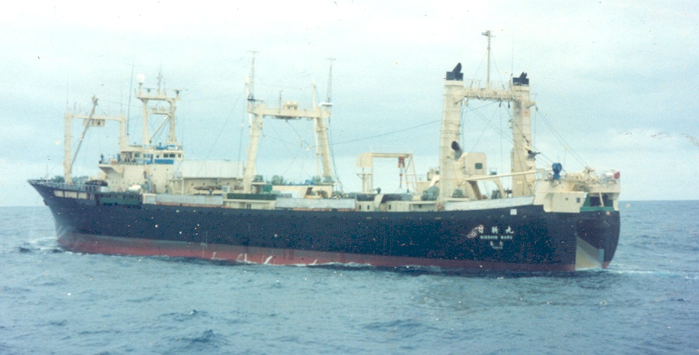

Slide 51
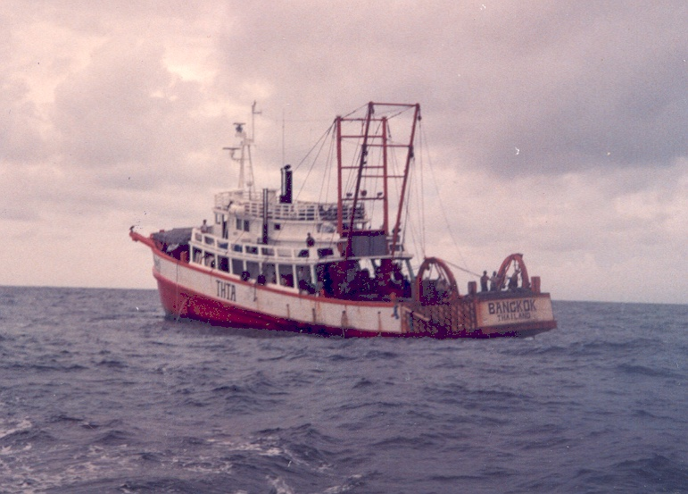
Thailand Trawler

