Slide 1
DATA MANAGEMENT AND REPORTING
PRIFO Introduction to Debriefing Training - Part A
Virtual Training Workshop 18th – 29th January 2021
Noumea, New Caledonia

Slide 2
Outline
Data Registry and Entry Process in TUFMAN2 (T2)
Status of Data Provision to SPC
Data Dissemination and Reporting through (DORADO)

Slide 3
Data Registry and Entry
Observer Trip Placements List provided to SPC and entered into T2
SPC received workbooks from programmes via hightail, or any other means such as hard drive, flash drive, Google drive and file servers
This include workbook plus reports (trip report, journal, debriefing evaluation form and score-sheet)
Preferred file format should be PDF or TIFF
Check for data completeness (request for re-scan if missing pages)
Register the trip data into T2 and assigned to DCTs for entry
Other programmes (FFA, WCPFC, FJ, SB, TO) enter their data directly into T2

Slide 4
What is TUFMAN2 (T2)?
Database system developed by SPC-OFP for entering all fisheries data such as log-sheets data, observer data, port sampling data, cannery data and artisanal data, as well linking these datasets to the VMS data and other Reference datasets
Currently used in production – SPC and its members, WCPFC and FFA are using T2
“Observer and Debriefing Modules in T2”

Slide 5
T2 System
Web apps
Mobile apps
Tufman 2
Web
Operational data
Tufman 2
database
Tails
Artisanal, port sampling, unloadings
View/edit
Send
Dorado Reports
On-Board
LL logsheet
OLLO
LL Observer
View
Send
National IMS/RIMF
VMS; catch-and-effort; licences; vessels etc…
FIMS
eLog; FAD buoy
Other ER
CLS, eTUNALOG etc

Slide 6
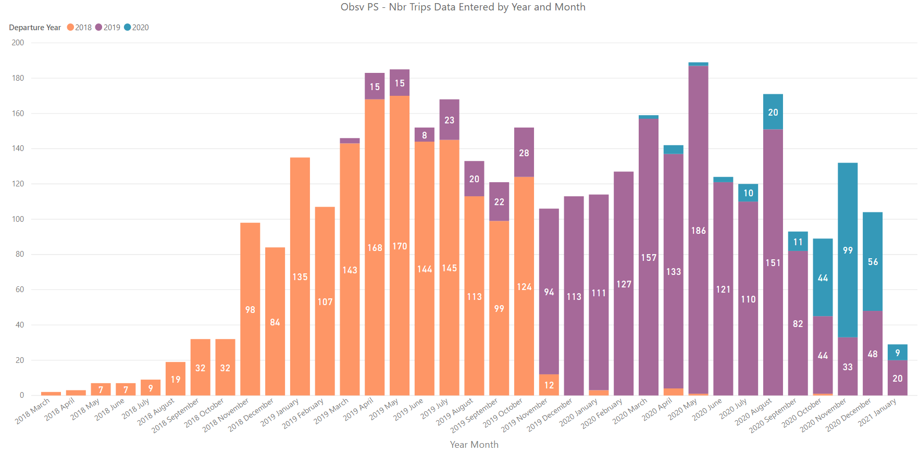
Status of Data Provision to SPC
Summary of PS trips entered by month

Slide 7
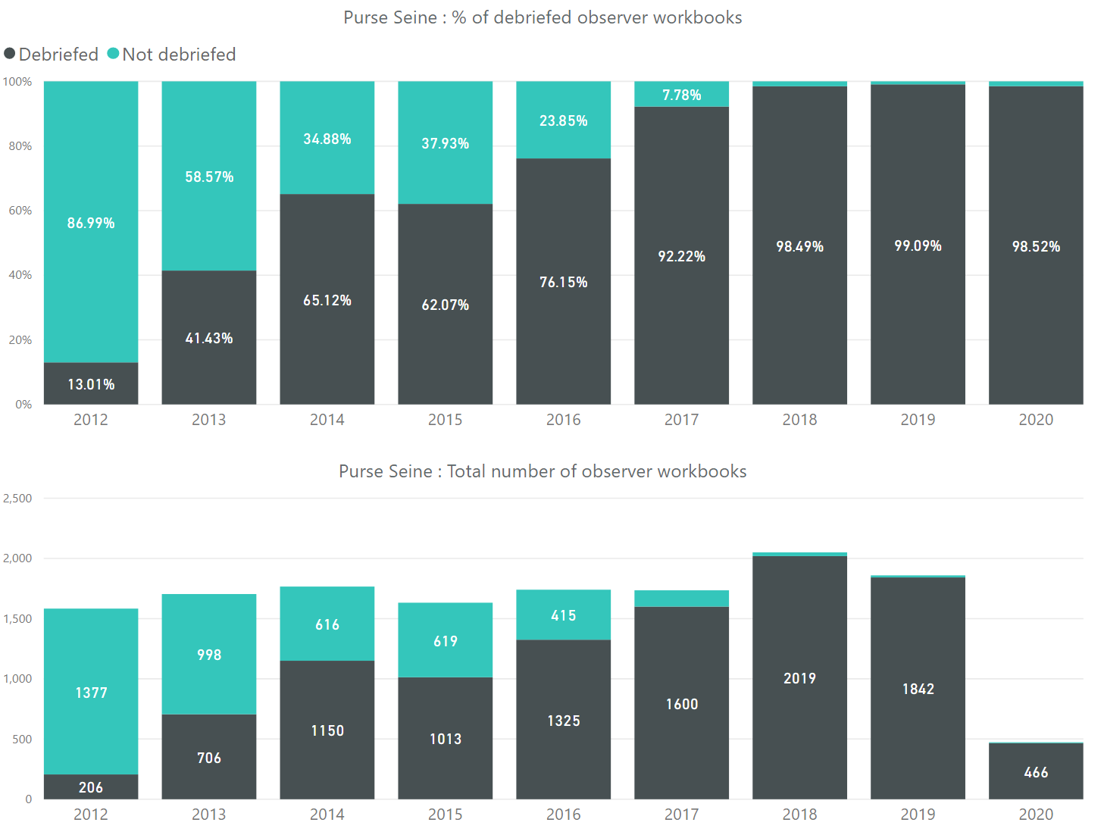
PS data processed in T2

Slide 8
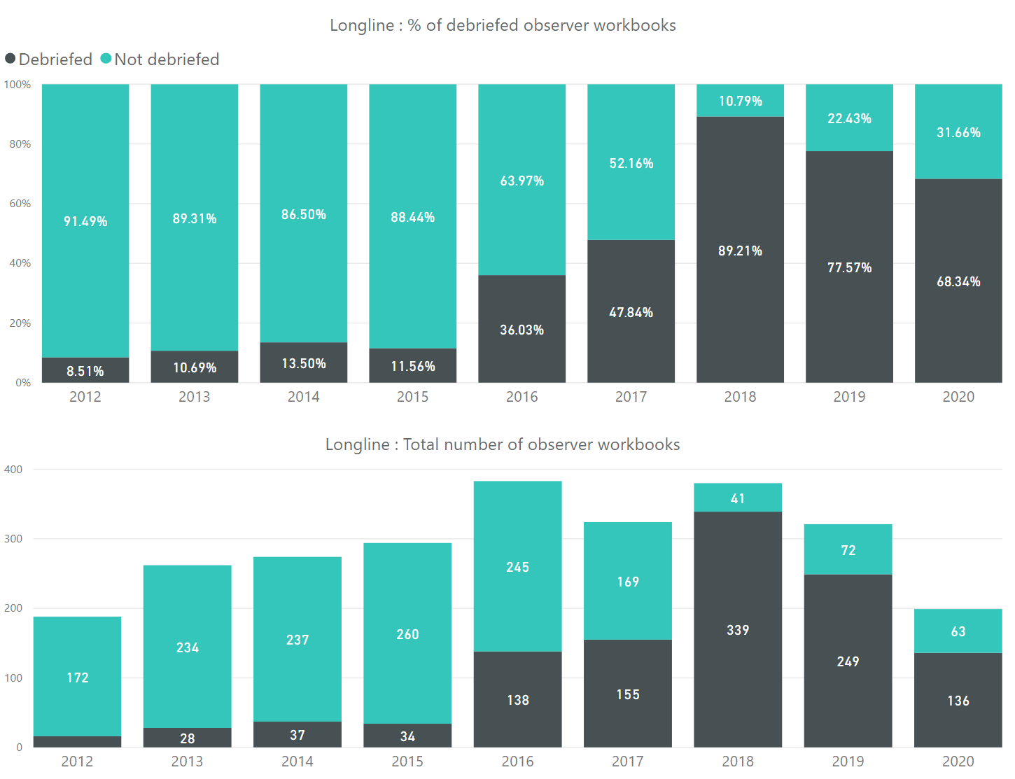
LL data processed in T2

Slide 9
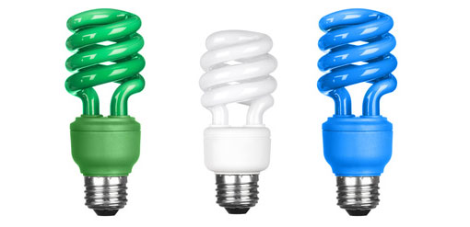
Data Dissemination and Reporting
DORADO - What is this tool?
- Web-based tool fully integrated with TUFMAN2
- Easy reports for countries to access online
- You can have data tables, maps & charts
- Application Programming Interface (API) used for data sharing

Slide 10
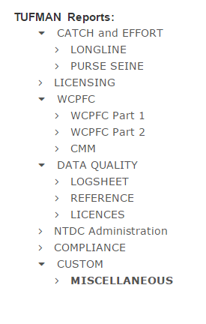
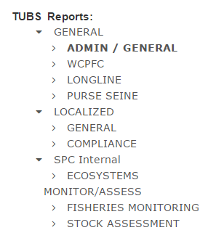
Report Components
Component 1
Component 2

Slide 11
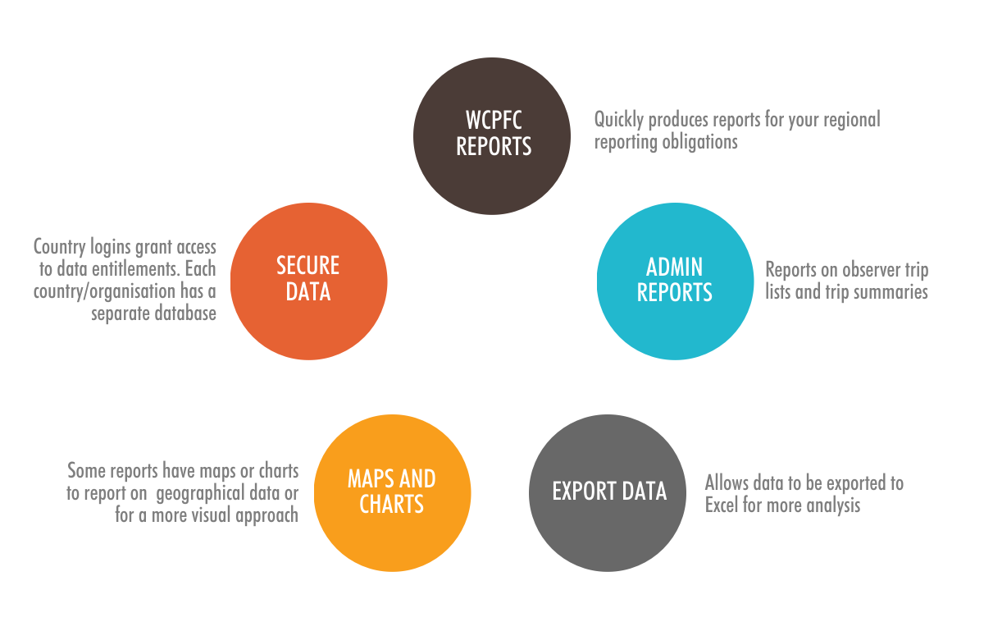
Report Features
Notes:
Dorado est l’outil qui permet grâce à des rapports d’accéder à la totalité de vos données stockées dans TUFMAN2
Les principales utilisations sont bien sûr les rapports destinés au comité.
Il offre aussi la possibilité de visualiser les données et de les exporter.

Slide 12
Report usages
This is YOUR data
Control, analyze and share relevant data
How could we make it more interactive, enabling data exploration?
Getting inspiration from other reporting and analytics tools
Need a new report? Just contact us!

Slide 13
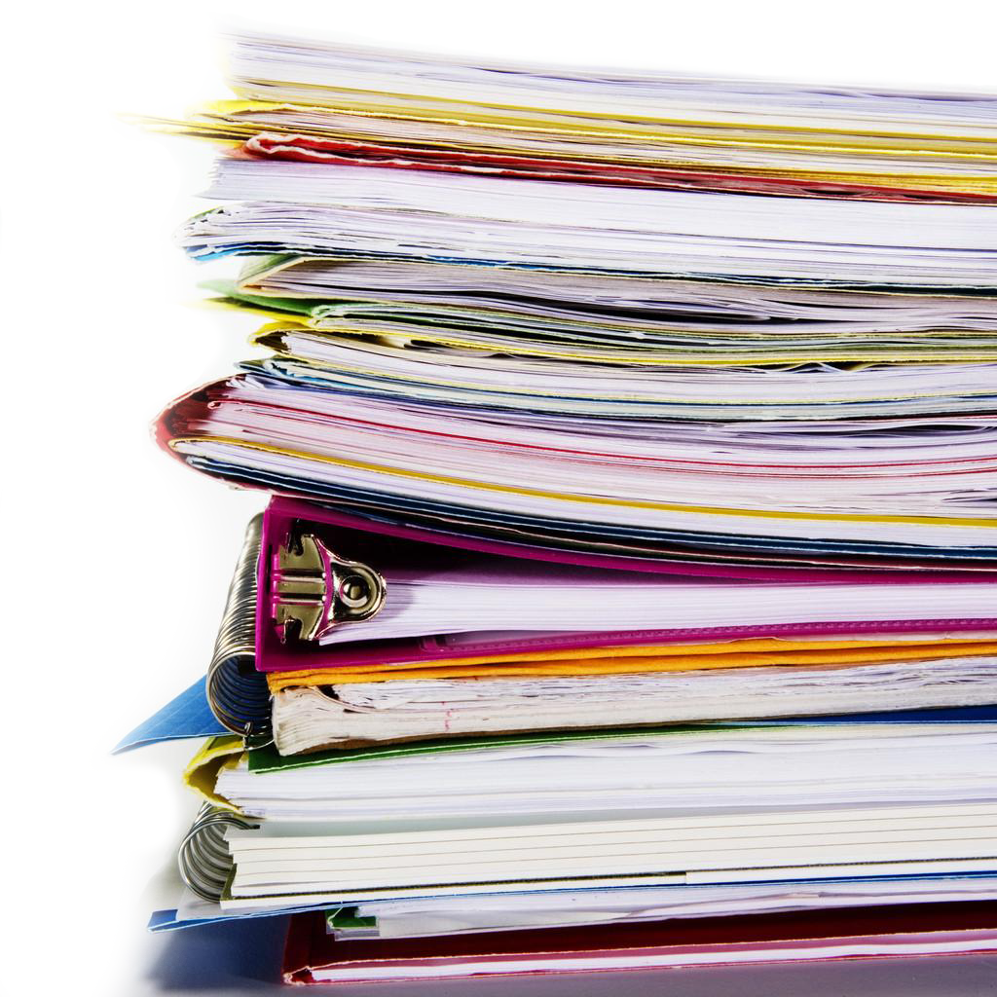
Question / Remarks ?
Thank You!

