Slide 1
Observer DATA management
Aurélien PANIZZA – SPC

Slide 2
Observer data management process (1/2) Observer workbooks
16 observer programmes
Data entry in the regional organisations and in the countries
9 local staff at SPC => 80% of the data entry
FFA, WCPFC
Fiji, Tonga, Salomon Islands, New Caledonia
SPC tools Tufman2 used for data entry (workbooks + debriefing forms)
OLLO for Longline E-reporting

Slide 3
Observer data management process (2/2) non Standard data & e-monitoring
NSD = Longline data collected not using the SPC’s forms
NZ, KR, TW, CN, AU, JP, HW
Data extracts submitted to WCPFC and SPC
Development of the “WCPFC ER standards” to ease data loadings
E-Monitoring data sent to SPC managed by SPC

Slide 4
Summary of the data flow
TUFMAN2
Non-Standard Data
DATA WAREHOUSE
E-Monitoring
WCPFC
Data Entry
25 000 trips
Scientists
Flat Files
10 000 trips
Flat Files
600 trips
DORADO

Slide 5
Data quality checks
Debriefing process
Take place at the end of the trip
Close to 100% trips debriefing since 2018
Data registry
Check missing forms, poor scan quality …
Full set : Workbook – Trip report – Journal – evaluation form – scoresheet
Data entry software checks
Unrealistic values (length …), potential typos (species, position …)
Manual audits on databases
Consolidation backfilling scripts
Clean-up dates / locations, estimation of # and weight, ROP trip, WCPFC data, data sharing …

Slide 6
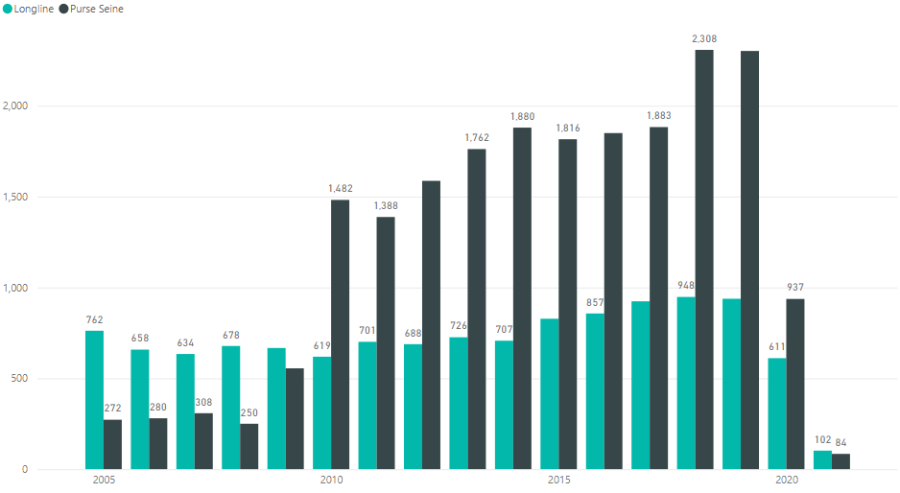
Observer data status

Slide 7
Observer data status
Purse Seine | Longline | Longline FJOB
21.000 Trips | 14.000 Trips | 1.600 trips
400.000 sets | 220.000 sets | 22.000 sets
1.5 millions catches records | 11.5 millions catches | 1 million catches
20 millions measurements (140k bycatch) | 6.5 millions measurements | 800.000 measurements

Slide 8
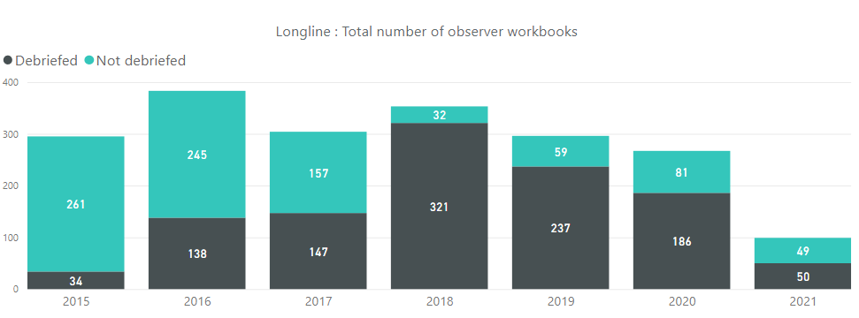
FJOB - debriefed workbooks coverage

Slide 9
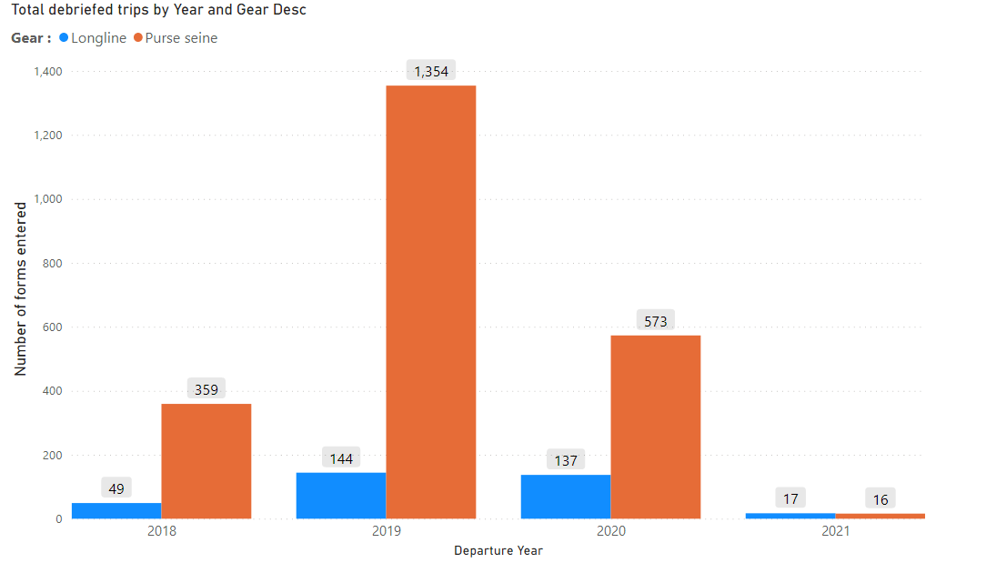
Debriefing forms available for reporting (All prg)

Slide 10
SPC data tools

Slide 11
OFFLINE LONG LINE OBSERVER

Slide 12
Longline E-reporting : “OLLO”
Stable
Tested and fully used at sea by NCOB, PFOB and TOOB
20+ “real” trips
Access the data using Tufman2 and Dorado
To be improved/developed:
Integration of the instructions found on the paper forms
Training (especially for the less experienced observers)
Summary of the collected and not collected data

Slide 13
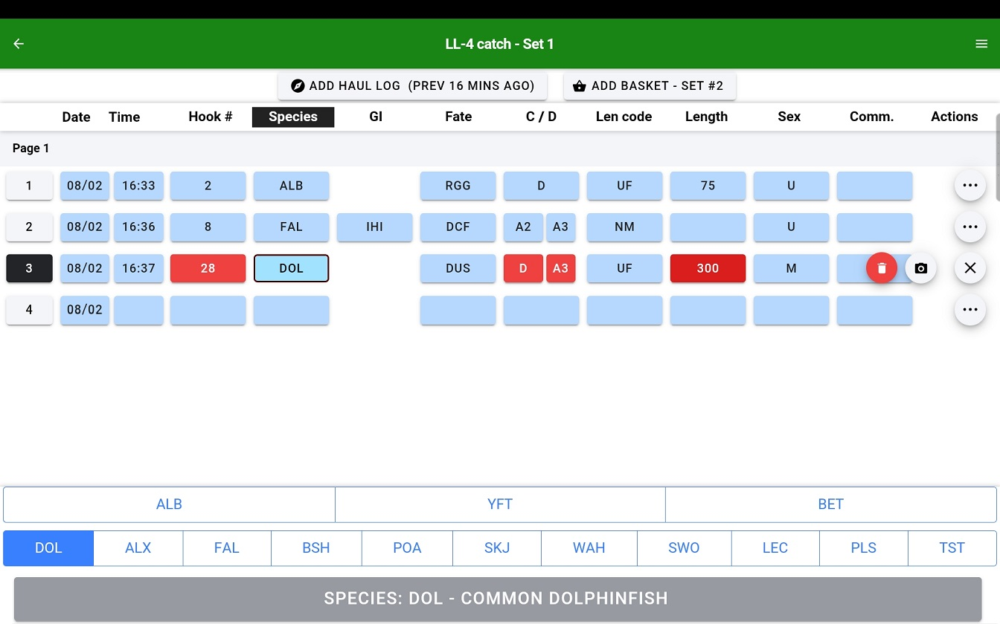

Slide 14
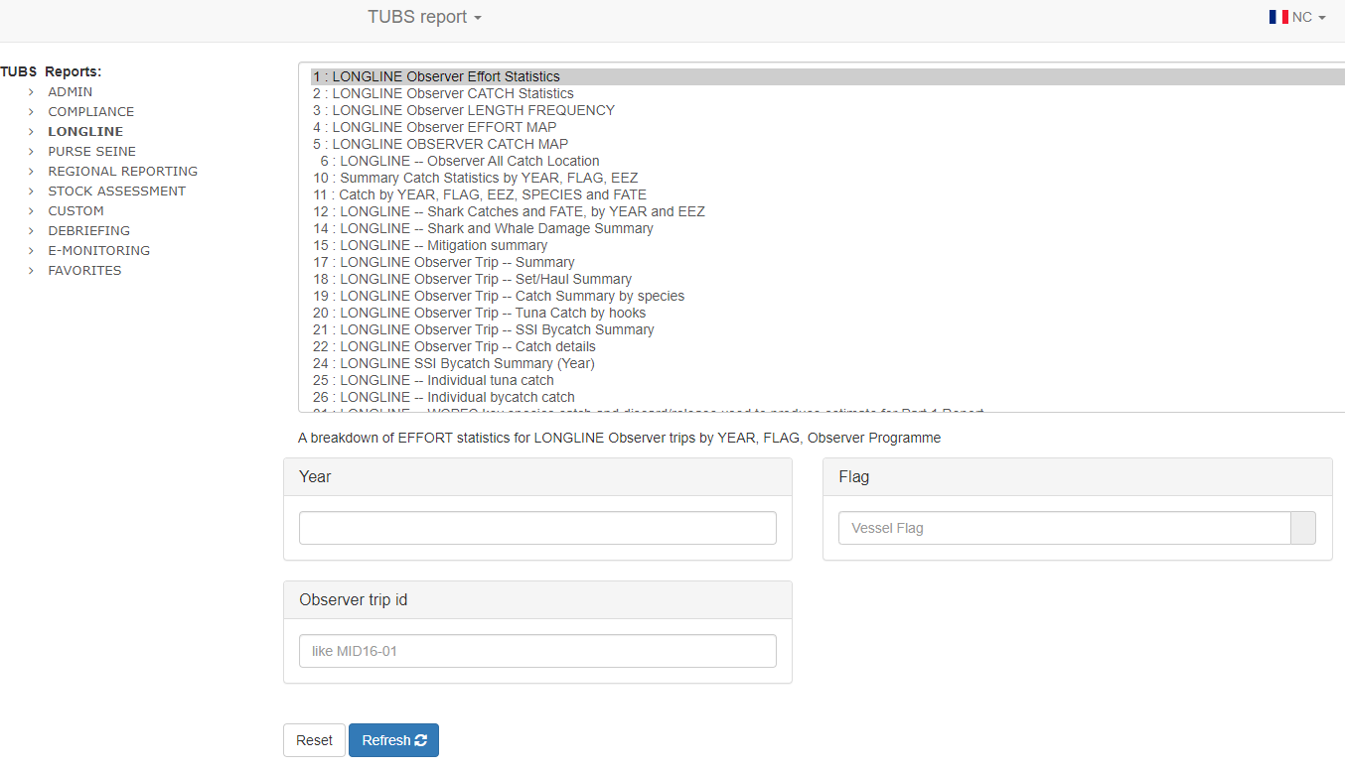
Dorado

Slide 15
Questions?

